Slide 1
Fundamentals of Ecology
Week 9, Ecology Lecture 7
Cara Brook
February 28, 2023

Slide 2
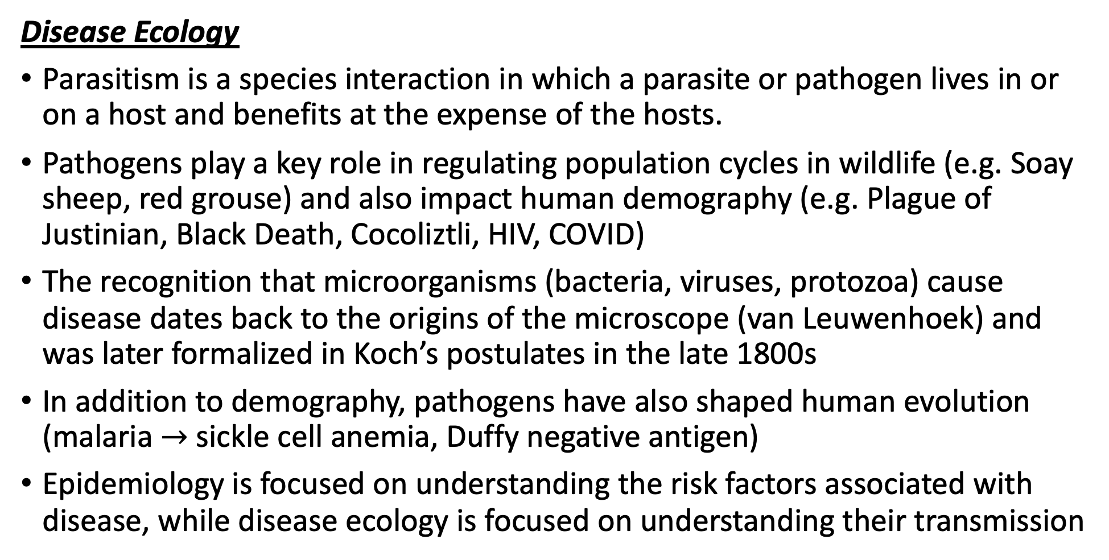
Let’s recap a bit!
Disease Ecology
Parasitism is a species interaction in which a parasite or pathogen lives in or on a host and benefits at the expense of the hosts.
Pathogens play a key role in regulating population cycles in wildlife (e.g. Soay sheep, red grouse) and also impact human demography (e.g. Plague of Justinian, Black Death, Cocoliztli, HIV, COVID)
The recognition that microorganisms (bacteria, viruses, protozoa) cause disease dates back to the origins of the microscope (van Leuwenhoek) and was later formalized in Koch’s postulates in the late 1800s
In addition to demography, pathogens have also shaped human evolution (malaria $→$ sickle cell anemia, Duffy negative antigen)
Epidemiology is focused on understanding the risk factors associated with disease, while disease ecology is focused on understanding their transmission
Disease Ecology
We learned about extensions to the SIR model that can be made to better represent diverse types of pathogens (e.g. dynamics different from classic measles).
These extensions included incorporating inherited maternal immunity into a disease model (important in the case of natural vs. vaccinated immunity in mothers), as well as modeling different types of pathogen transmission.
Environmental disease transmission occurs when the pathogen is maintained outside the host in an environmental reservoir. We learned a few approaches to modeling this type of pathogen. Example: cholera, with water-borne transmission.
Vertical transmission occurs when a pathogen is passed mother-to-infant in utero. We learned how to model this in the case of HIV- and also learned a few details about this pathogen.
Vector-borne transmission occurs when a pathogen is transmitted via blood-feeding arthropod (tick, flea, mosquito). We learned the specifics of how vector-borne disease are modeled in the case of malaria.

Slide 3
Let’s recap a bit!
Disease Ecology
Parasitism is a species interaction in which a parasite or pathogen lives in or on a host and benefits at the expense of the hosts.
Pathogens play a key role in regulating population cycles in wildlife (e.g. Soay sheep, red grouse) and also impact human demography (e.g. Plague of Justinian, Black Death, Cocoliztli, HIV, COVID)
The recognition that microorganisms (bacteria, viruses, protozoa) cause disease dates back to the origins of the microscope (van Leuwenhoek) and was later formalized in Koch’s postulates in the late 1800s
In addition to demography, pathogens have also shaped human evolution (malaria $→$ sickle cell anemia, Duffy negative antigen)
Epidemiology is focused on understanding the risk factors associated with disease, while disease ecology is focused on understanding their transmission
Disease Ecology
We learned about extensions to the SIR model that can be made to better represent diverse types of pathogens (e.g. dynamics different from classic measles).
These extensions included incorporating inherited maternal immunity into a disease model (important in the case of natural vs. vaccinated immunity in mothers), as well as modeling different types of pathogen transmission.
Environmental disease transmission occurs when the pathogen is maintained outside the host in an environmental reservoir. We learned a few approaches to modeling this type of pathogen. Example: cholera, with water-borne transmission.
Vertical transmission occurs when a pathogen is passed mother-to-infant in utero. We learned how to model this in the case of HIV- and also learned a few details about this pathogen.
Vector-borne transmission occurs when a pathogen is transmitted via blood-feeding arthropod (tick, flea, mosquito). We learned the specifics of how vector-borne disease are modeled in the case of malaria.

Slide 4
Let’s recap a bit!
Disease Ecology
Parasitism is a species interaction in which a parasite or pathogen lives in or on a host and benefits at the expense of the hosts.
Pathogens play a key role in regulating population cycles in wildlife (e.g. Soay sheep, red grouse) and also impact human demography (e.g. Plague of Justinian, Black Death, Cocoliztli, HIV, COVID)
The recognition that microorganisms (bacteria, viruses, protozoa) cause disease dates back to the origins of the microscope (van Leuwenhoek) and was later formalized in Koch’s postulates in the late 1800s
In addition to demography, pathogens have also shaped human evolution (malaria $→$ sickle cell anemia, Duffy negative antigen)
Epidemiology is focused on understanding the risk factors associated with disease, while disease ecology is focused on understanding their transmission
Disease Ecology
We learned about extensions to the SIR model that can be made to better represent diverse types of pathogens (e.g. dynamics different from classic measles).
These extensions included incorporating inherited maternal immunity into a disease model (important in the case of natural vs. vaccinated immunity in mothers), as well as modeling different types of pathogen transmission.
Environmental disease transmission occurs when the pathogen is maintained outside the host in an environmental reservoir. We learned a few approaches to modeling this type of pathogen. Example: cholera, with water-borne transmission.
Vertical transmission occurs when a pathogen is passed mother-to-infant in utero. We learned how to model this in the case of HIV- and also learned a few details about this pathogen.
Vector-borne transmission occurs when a pathogen is transmitted via blood-feeding arthropod (tick, flea, mosquito). We learned the specifics of how vector-borne disease are modeled in the case of malaria.

Slide 5
Let’s recap a bit!
Disease Ecology
Parasitism is a species interaction in which a parasite or pathogen lives in or on a host and benefits at the expense of the hosts.
Pathogens play a key role in regulating population cycles in wildlife (e.g. Soay sheep, red grouse) and also impact human demography (e.g. Plague of Justinian, Black Death, Cocoliztli, HIV, COVID)
The recognition that microorganisms (bacteria, viruses, protozoa) cause disease dates back to the origins of the microscope (van Leuwenhoek) and was later formalized in Koch’s postulates in the late 1800s
In addition to demography, pathogens have also shaped human evolution (malaria $→$ sickle cell anemia, Duffy negative antigen)
Epidemiology is focused on understanding the risk factors associated with disease, while disease ecology is focused on understanding their transmission
Disease Ecology
We learned about extensions to the SIR model that can be made to better represent diverse types of pathogens (e.g. dynamics different from classic measles).
These extensions included incorporating inherited maternal immunity into a disease model (important in the case of natural vs. vaccinated immunity in mothers), as well as modeling different types of pathogen transmission.
Environmental disease transmission occurs when the pathogen is maintained outside the host in an environmental reservoir. We learned a few approaches to modeling this type of pathogen. Example: cholera, with water-borne transmission.
Vertical transmission occurs when a pathogen is passed mother-to-infant in utero. We learned how to model this in the case of HIV- and also learned a few details about this pathogen.
Vector-borne transmission occurs when a pathogen is transmitted via blood-feeding arthropod (tick, flea, mosquito). We learned the specifics of how vector-borne disease are modeled in the case of malaria.

Slide 6
Let’s recap a bit!
Disease Ecology
Parasitism is a species interaction in which a parasite or pathogen lives in or on a host and benefits at the expense of the hosts.
Pathogens play a key role in regulating population cycles in wildlife (e.g. Soay sheep, red grouse) and also impact human demography (e.g. Plague of Justinian, Black Death, Cocoliztli, HIV, COVID)
The recognition that microorganisms (bacteria, viruses, protozoa) cause disease dates back to the origins of the microscope (van Leuwenhoek) and was later formalized in Koch’s postulates in the late 1800s
In addition to demography, pathogens have also shaped human evolution (malaria $→$ sickle cell anemia, Duffy negative antigen)
Epidemiology is focused on understanding the risk factors associated with disease, while disease ecology is focused on understanding their transmission
Disease Ecology
We learned about extensions to the SIR model that can be made to better represent diverse types of pathogens (e.g. dynamics different from classic measles).
These extensions included incorporating inherited maternal immunity into a disease model (important in the case of natural vs. vaccinated immunity in mothers), as well as modeling different types of pathogen transmission.
Environmental disease transmission occurs when the pathogen is maintained outside the host in an environmental reservoir. We learned a few approaches to modeling this type of pathogen. Example: cholera, with water-borne transmission.
Vertical transmission occurs when a pathogen is passed mother-to-infant in utero. We learned how to model this in the case of HIV- and also learned a few details about this pathogen.
Vector-borne transmission occurs when a pathogen is transmitted via blood-feeding arthropod (tick, flea, mosquito). We learned the specifics of how vector-borne disease are modeled in the case of malaria.

Slide 7
Let’s recap a bit!
Disease Ecology
Parasitism is a species interaction in which a parasite or pathogen lives in or on a host and benefits at the expense of the hosts.
Pathogens play a key role in regulating population cycles in wildlife (e.g. Soay sheep, red grouse) and also impact human demography (e.g. Plague of Justinian, Black Death, Cocoliztli, HIV, COVID)
The recognition that microorganisms (bacteria, viruses, protozoa) cause disease dates back to the origins of the microscope (van Leuwenhoek) and was later formalized in Koch’s postulates in the late 1800s
In addition to demography, pathogens have also shaped human evolution (malaria $→$ sickle cell anemia, Duffy negative antigen)
Epidemiology is focused on understanding the risk factors associated with disease, while disease ecology is focused on understanding their transmission
Disease Ecology
We learned about extensions to the SIR model that can be made to better represent diverse types of pathogens (e.g. dynamics different from classic measles).
These extensions included incorporating inherited maternal immunity into a disease model (important in the case of natural vs. vaccinated immunity in mothers), as well as modeling different types of pathogen transmission.
Environmental disease transmission occurs when the pathogen is maintained outside the host in an environmental reservoir. We learned a few approaches to modeling this type of pathogen. Example: cholera, with water-borne transmission.
Vertical transmission occurs when a pathogen is passed mother-to-infant in utero. We learned how to model this in the case of HIV- and also learned a few details about this pathogen.
Vector-borne transmission occurs when a pathogen is transmitted via blood-feeding arthropod (tick, flea, mosquito). We learned the specifics of how vector-borne disease are modeled in the case of malaria.

Slide 8
Let’s recap a bit!
Disease Ecology
We explored advances in malaria modeling, starting with the simplest Ross model, then adding a mosquito incubation period in the MacDonald model, then adding a human incubation period in the Anderson and May model.
Incorporation of the mosquito incubation period in the MacDonald model led to the insight that the survival of the female mosquito is a weak point in the malaria transmission cycle, which inspired decades of WHO malaria control via spraying of the insecticide DDT.
We learned terminology for zoonotic diseases, those transmitted from wildlife reservoirs to human spillover hosts.
Spillback occurs when pathogens transmit from the spillover host back to the reservoir that sourced the infection, as in the case of mink transmission of SARS-CoV-2 to humans.
We can classify pathogens into stage I-V based on their R₀ in the human population. Zoonotic pathogens encompass stages II-IV.

Slide 9
Let’s recap a bit!
Disease Ecology
We explored advances in malaria modeling, starting with the simplest Ross model, then adding a mosquito incubation period in the MacDonald model, then adding a human incubation period in the Anderson and May model.
Incorporation of the mosquito incubation period in the MacDonald model led to the insight that the survival of the female mosquito is a weak point in the malaria transmission cycle, which inspired decades of WHO malaria control via spraying of the insecticide DDT.
We learned terminology for zoonotic diseases, those transmitted from wildlife reservoirs to human spillover hosts.
Spillback occurs when pathogens transmit from the spillover host back to the reservoir that sourced the infection, as in the case of mink transmission of SARS-CoV-2 to humans.
We can classify pathogens into stage I-V based on their R₀ in the human population. Zoonotic pathogens encompass stages II-IV.

Slide 10
Let’s recap a bit!
Disease Ecology
We explored advances in malaria modeling, starting with the simplest Ross model, then adding a mosquito incubation period in the MacDonald model, then adding a human incubation period in the Anderson and May model.
Incorporation of the mosquito incubation period in the MacDonald model led to the insight that the survival of the female mosquito is a weak point in the malaria transmission cycle, which inspired decades of WHO malaria control via spraying of the insecticide DDT.
We learned terminology for zoonotic diseases, those transmitted from wildlife reservoirs to human spillover hosts.
Spillback occurs when pathogens transmit from the spillover host back to the reservoir that sourced the infection, as in the case of mink transmission of SARS-CoV-2 to humans.
We can classify pathogens into stage I-V based on their R₀ in the human population. Zoonotic pathogens encompass stages II-IV.

Slide 11
Let’s recap a bit!
Disease Ecology
We explored advances in malaria modeling, starting with the simplest Ross model, then adding a mosquito incubation period in the MacDonald model, then adding a human incubation period in the Anderson and May model.
Incorporation of the mosquito incubation period in the MacDonald model led to the insight that the survival of the female mosquito is a weak point in the malaria transmission cycle, which inspired decades of WHO malaria control via spraying of the insecticide DDT.
We learned terminology for zoonotic diseases, those transmitted from wildlife reservoirs to human spillover hosts.
Spillback occurs when pathogens transmit from the spillover host back to the reservoir that sourced the infection, as in the case of mink transmission of SARS-CoV-2 to humans.
We can classify pathogens into stage I-V based on their R₀ in the human population. Zoonotic pathogens encompass stages II-IV.

Slide 12
Let’s recap a bit!
Disease Ecology
We explored advances in malaria modeling, starting with the simplest Ross model, then adding a mosquito incubation period in the MacDonald model, then adding a human incubation period in the Anderson and May model.
Incorporation of the mosquito incubation period in the MacDonald model led to the insight that the survival of the female mosquito is a weak point in the malaria transmission cycle, which inspired decades of WHO malaria control via spraying of the insecticide DDT.
We learned terminology for zoonotic diseases, those transmitted from wildlife reservoirs to human spillover hosts.
Spillback occurs when pathogens transmit from the spillover host back to the reservoir that sourced the infection, as in the case of mink transmission of SARS-CoV-2 to humans.
We can classify pathogens into stage I-V based on their R₀ in the human population. Zoonotic pathogens encompass stages II-IV.

Slide 13
Modeling zoonotic pathogens typically necessitates modeling epidemic dynamics in multiple host populations.
Plague has added complexity as a vector-borne pathogen!

Slide 14
Modeling zoonotic pathogens typically necessitates modeling epidemic dynamics in multiple host populations.
Plague has added complexity as a vector-borne pathogen!

Slide 15

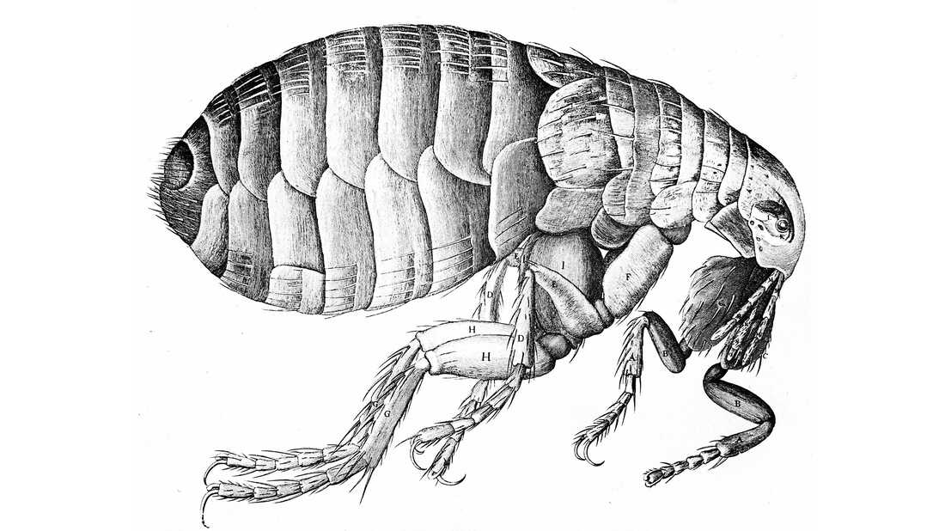
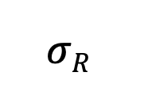
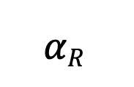
Modeling zoonotic pathogens typically necessitates modeling epidemic dynamics in multiple host populations.
Plague has added complexity as a vector-borne pathogen!
μ_{R}
μ_{R}
$$αR$$
b_{R}
β_{R}
$$σR$$
μ_{R}
S_{R}
I_{R}
R_{R}
Rat reservoir dynamics
b_{F}
S_{F}
β_{F}
I_{FR}
Rats get infected from contact with infectious fleas. Fleas get infected from contact with infectious rats.
μ_{F}
μ_{F}

Slide 16

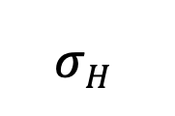
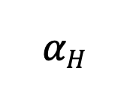
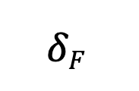
Modeling zoonotic pathogens typically necessitates modeling epidemic dynamics in multiple host populations.
Plague has added complexity as a vector-borne pathogen!
μ_{R}
μ_{R}
$$αR$$
b_{R}
β_{R}
$$σR$$
μ_{R}
S_{R}
I_{R}
R_{R}
b_{F}
S_{F}
β_{F}
I_{FR}
$$δF$$
I_{FF}
μ_{F}
μ_{F}
μ_{F}
Humans get infected from contact with free-living infectious fleas!
b_{H}
β_{H}
$$σH$$
μ_{H}
S_{H}
I_{H}
R_{H}
$$αH$$
μ_{H}
μ_{H}

Slide 17
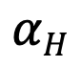
Modeling zoonotic pathogens typically necessitates modeling epidemic dynamics in multiple host populations.
Plague has added complexity as a vector-borne pathogen!
μ_{R}
μ_{R}
$$αR$$
b_{R}
β_{R}
$$σR$$
μ_{R}
S_{R}
I_{R}
R_{R}
How many equations would we need to model this system?
b_{F}
S_{F}
β_{F}
I_{FR}
$$δF$$
I_{FF}
μ_{F}
μ_{F}
μ_{F}
μ_{H}
b_{H}
β_{H}
$$σH$$
μ_{H}
S_{H}
I_{H}
R_{H}
$$αH$$
μ_{H}

Slide 18
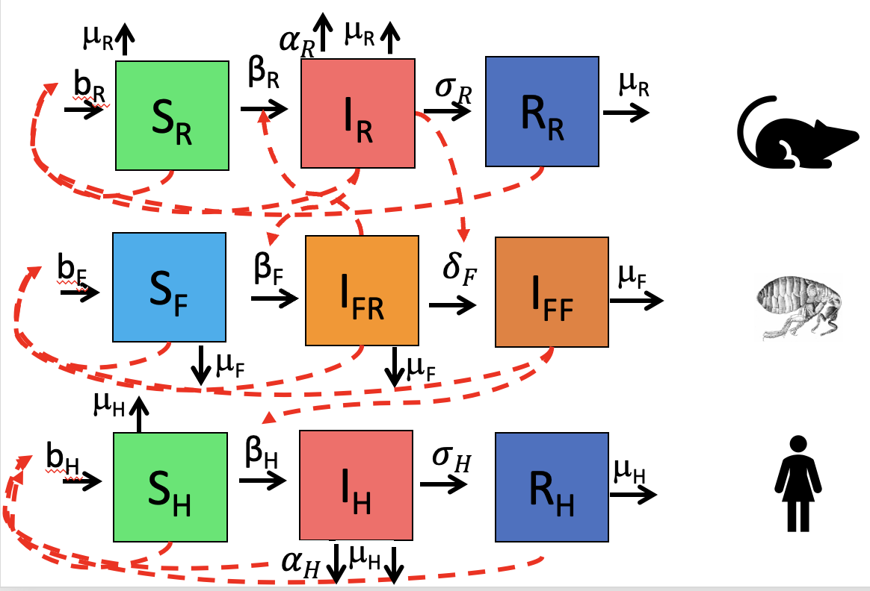

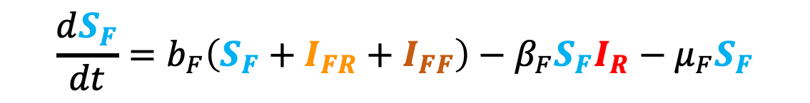

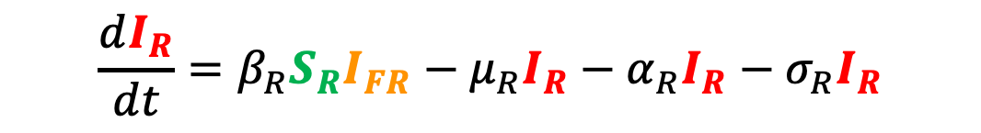

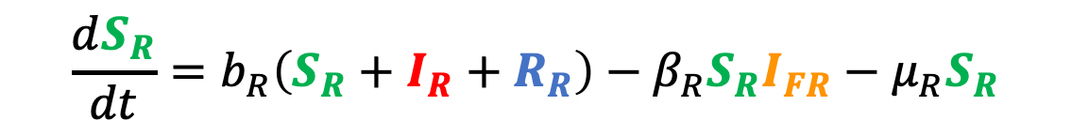
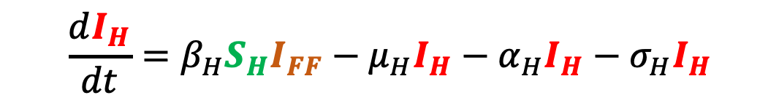

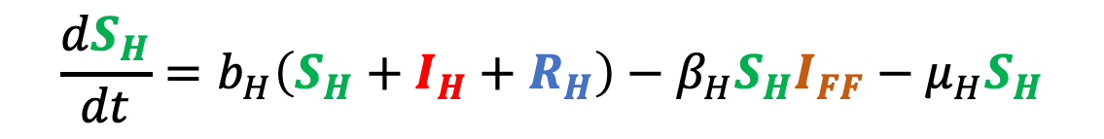
$$\frac{dS_{R}}{dt}=b_{R}\left(S_{R}+I_{R}+R_{R}\right)−β_{R}S_{R}I_{FR}−μ_{R}S_{R}$$
A simple plague model
$$\frac{dI_{R}}{dt}=β_{R}S_{R}I_{FR}−μ_{R}I_{R}−α_{R}I_{R}−σ_{R}I_{R}$$
Rats
$$\frac{dR_{R}}{dt}=σ_{R}I_{R}−μ_{R}R_{R}$$
$$\frac{dS_{F}}{dt}=b_{F}\left(S_{F}+I_{FR}+I_{FF}\right)−β_{F}S_{F}I_{R}−μ_{F}S_{F}$$
$$\frac{dI_{FR}}{dt}=β_{F}S_{F}I_{R}−δI_{FR}−μ_{F}I_{FR}$$
Fleas
$$\frac{dI_{FF}}{dt}=δI_{FR}{−μ}_{F}I_{FF}$$
$$\frac{dS_{H}}{dt}=b_{H}\left(S_{H}+I_{H}+R_{H}\right)−β_{H}S_{H}I_{FF}−μ_{H}S_{H}$$
$$\frac{dI_{H}}{dt}=β_{H}S_{H}I_{FF}−μ_{H}I_{H}−α_{H}I_{H}−σ_{H}I_{H}$$
Humans
$$\frac{dR_{H}}{dt}=σ_{H}I_{H}−μ_{H}R_{H}$$

Slide 19
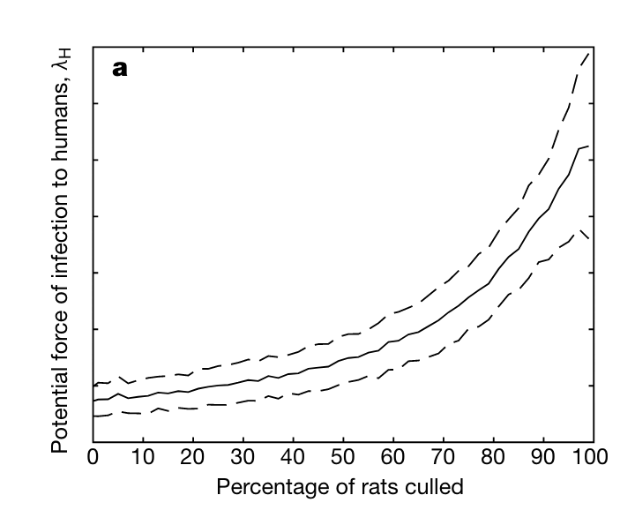
Fleas get infected from rats.
Humans get infected from free-living infected fleas!
“…from April 18 onwards, quantities of dead or dying rats were found in factories and warehouses…From the outer suburbs to the center of the town, in all the byways where the doctor's duties took him, in every thoroughfare, rats were piled up in garbage cans or lying in long lines in the gutters…On the fourth day the rats began to come out and die in batches…”
--La Peste, Albert Camus (1948)
Keeling and Gilligan. 2000. Nature.

Slide 20
Humans get infected from free-living infected fleas!
“…from April 18 onwards, quantities of dead or dying rats were found in factories and warehouses…From the outer suburbs to the center of the town, in all the byways where the doctor's duties took him, in every thoroughfare, rats were piled up in garbage cans or lying in long lines in the gutters…On the fourth day the rats began to come out and die in batches…”
--La Peste, Albert Camus (1948)
Keeling and Gilligan. 2000. Nature.

Slide 21
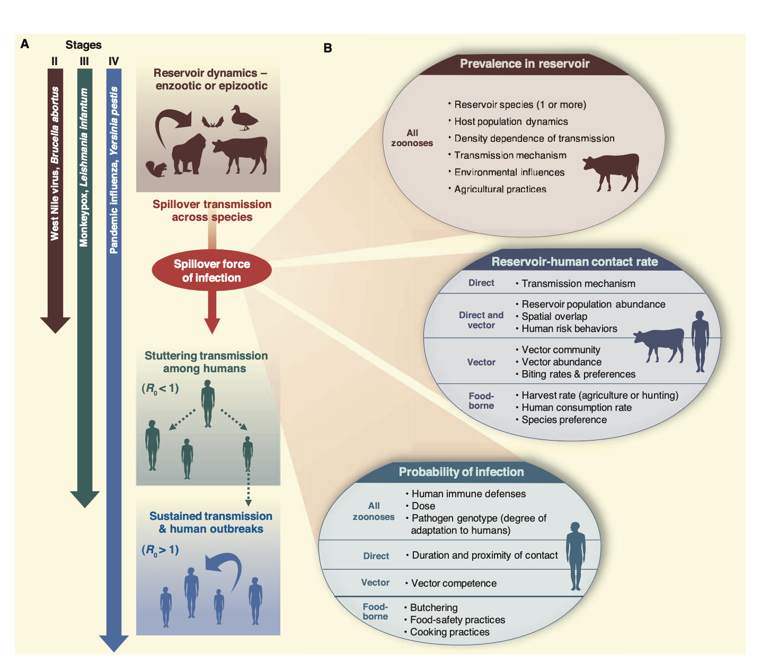
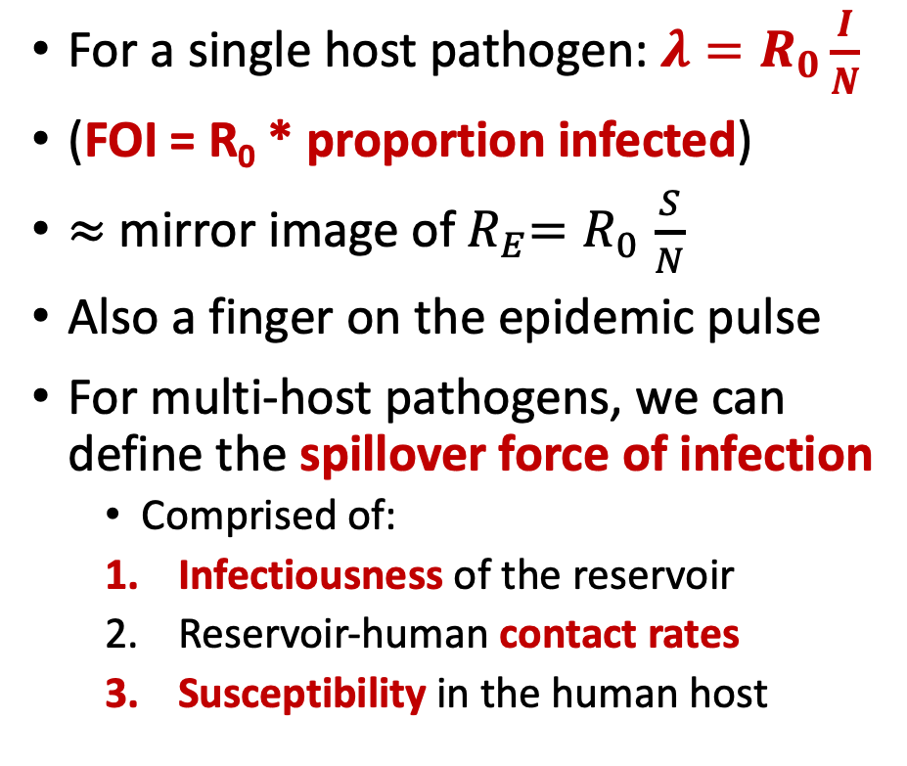
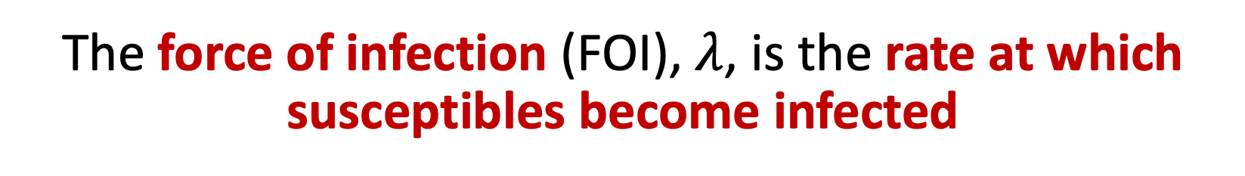
The force of infection (FOI), $λ$, is the rate at which susceptibles become infected
For a single host pathogen: ${λ=R}_{0}\frac{I}{N}$
(FOI = R₀ * proportion infected)
$≈$ mirror image of${ R}_{E}{=R}_{0}\frac{S}{N}$
Also a finger on the epidemic pulse
For multi-host pathogens, we can define the spillover force of infection
Comprised of:
Infectiousness of the reservoir
Reservoir-human contact rates
Susceptibility in the human host
Lloyd-Smith et al. 2009. Science.

Slide 22
The force of infection (FOI), $λ$, is the rate at which susceptibles become infected
For a single host pathogen: ${λ=R}_{0}\frac{I}{N}$
(FOI = R₀ * proportion infected)
$≈$ mirror image of${ R}_{E}{=R}_{0}\frac{S}{N}$
Also a finger on the epidemic pulse
For multi-host pathogens, we can define the spillover force of infection
Comprised of:
Infectiousness of the reservoir
Reservoir-human contact rates
Susceptibility in the human host
Lloyd-Smith et al. 2009. Science.

Slide 23
The force of infection (FOI), $λ$, is the rate at which susceptibles become infected
For a single host pathogen: ${λ=R}_{0}\frac{I}{N}$
(FOI = R₀ * proportion infected)
$≈$ mirror image of${ R}_{E}{=R}_{0}\frac{S}{N}$
Also a finger on the epidemic pulse
For multi-host pathogens, we can define the spillover force of infection
Comprised of:
Infectiousness of the reservoir
Reservoir-human contact rates
Susceptibility in the human host
Lloyd-Smith et al. 2009. Science.

Slide 24
The force of infection (FOI), $λ$, is the rate at which susceptibles become infected
For a single host pathogen: ${λ=R}_{0}\frac{I}{N}$
(FOI = R₀ * proportion infected)
$≈$ mirror image of${ R}_{E}{=R}_{0}\frac{S}{N}$
Also a finger on the epidemic pulse
For multi-host pathogens, we can define the spillover force of infection
Comprised of:
Infectiousness of the reservoir
Reservoir-human contact rates
Susceptibility in the human host
Lloyd-Smith et al. 2009. Science.

Slide 25
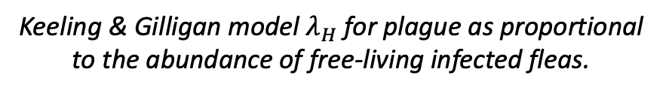
The force of infection (FOI), $λ$, is the rate at which susceptibles become infected
For a single host pathogen: ${λ=R}_{0}\frac{I}{N}$
(FOI = R₀ * proportion infected)
$≈$ mirror image of${ R}_{E}{=R}_{0}\frac{S}{N}$
Also a finger on the epidemic pulse
For multi-host pathogens, we can define the spillover force of infection
Comprised of:
Infectiousness of the reservoir
Reservoir-human contact rates
Susceptibility in the human host
Keeling & Gilligan model $λ_{H}$ for plague as proportional to the abundance of free-living infected fleas.
Lloyd-Smith et al. 2009. Science.

Slide 26
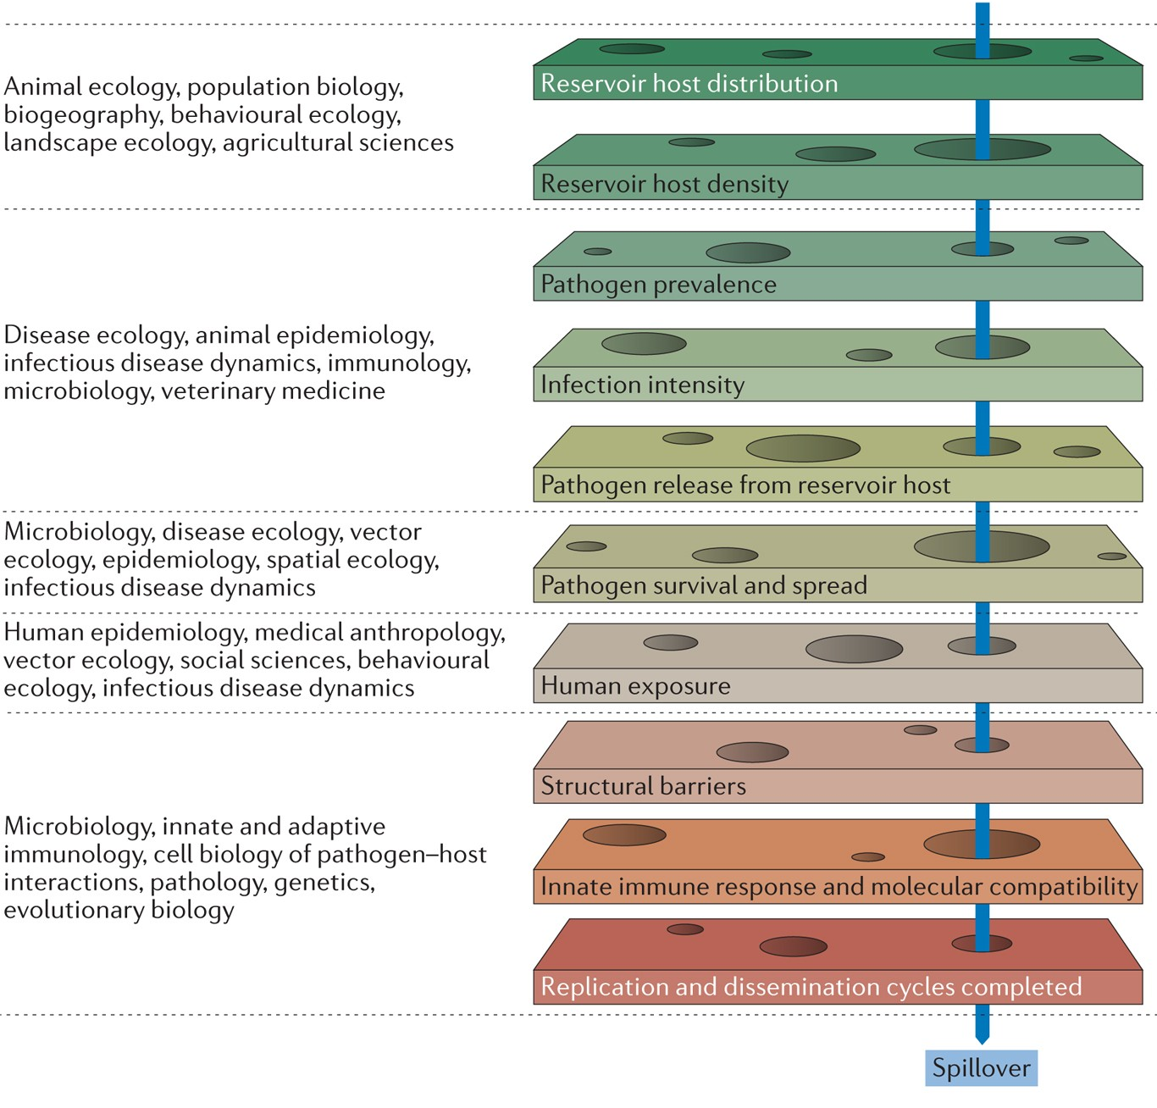
Zoonosis is a series of improbable events.
Plowright et al. 2017. Nature Reviews Microbiology.

Slide 27
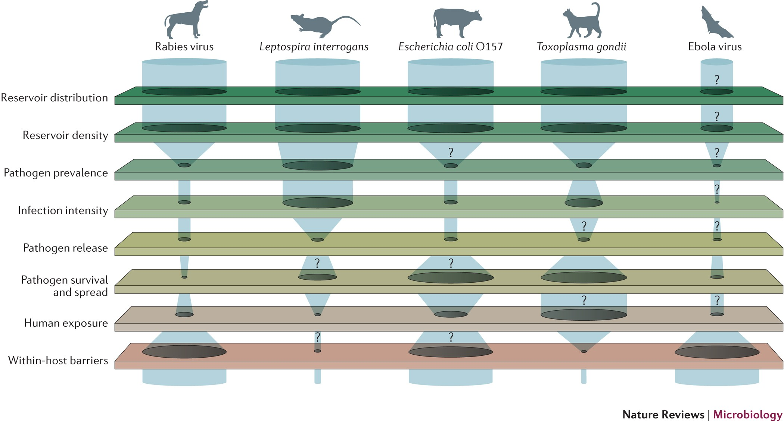
Bottlenecks to spillover.
Plowright et al. 2017. Nature Reviews Microbiology.

Slide 28
What’s so special about bats?
Plowright et al. 2017. Nature Reviews Microbiology.

Slide 29
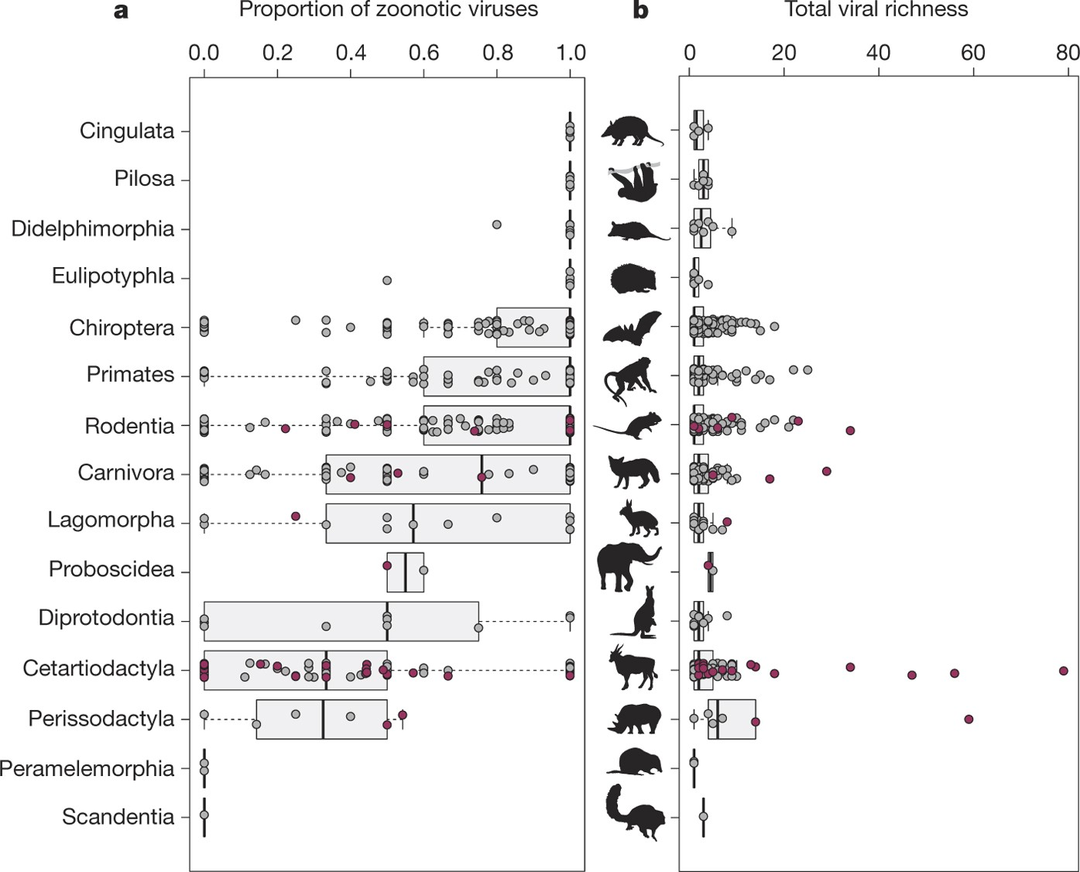
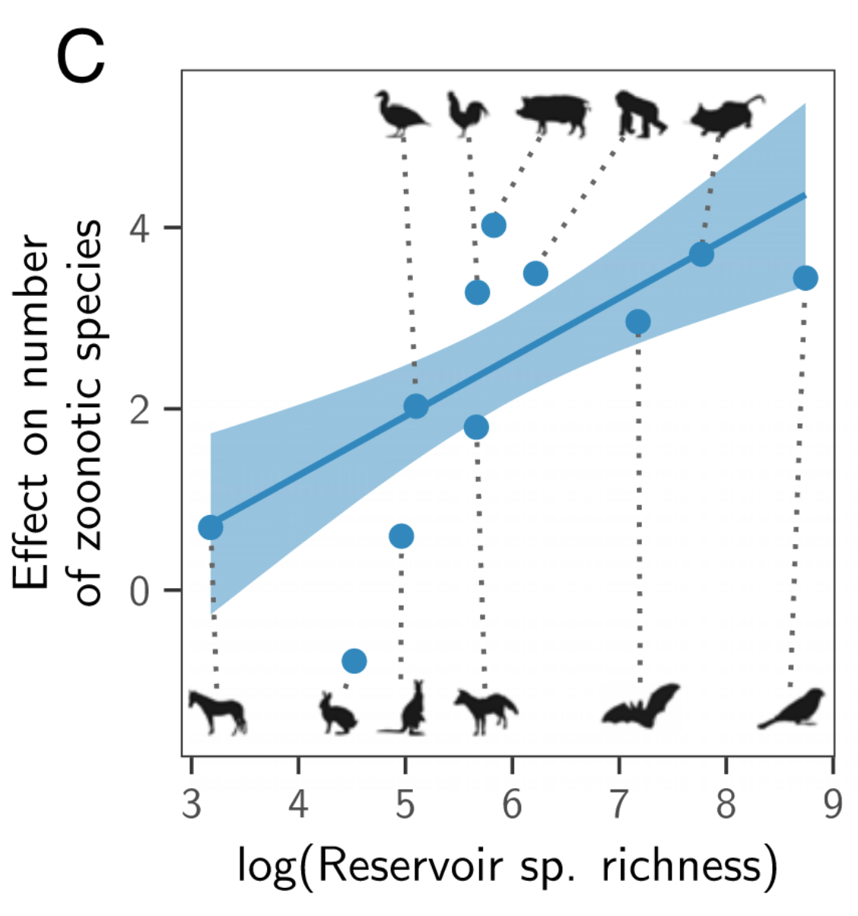
It is debated whether bats are reservoir hosts for more zoonotic viruses than other mammals.
Bats host a higher proportion of zoonotic viruses than other mammalian orders.
The number of zoonotic viruses hosted by bats scales with the total number of bat species in existence (>1400 spp.; 20% of mammalian diversity).
Olival et al. 2017. Nature.
Mollentze & Streicker. 2020. PNAS.

Slide 30
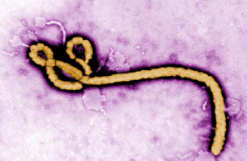
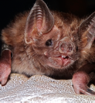
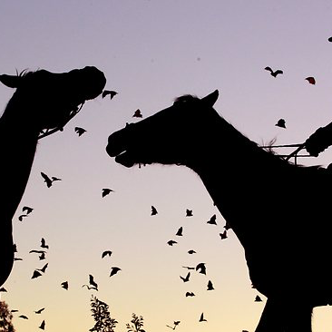
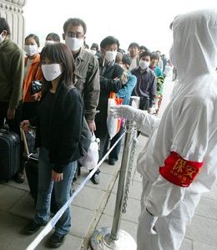
Ebola & Marburg filovirus
Hendra & Nipah henipavirus
Rabies lyssavirus
But it is known that bats do act as natural reservoirs and maintenance hosts for the majority of the world’s most virulent zoonotic viruses.
SARS, MERS, SARS-CoV-2 coronaviruses
Notes:
Leading researchers to ask, are bats somehow special in their capacity as zoonotic hosts?

Slide 31

Bats are natural reservoir hosts for several subgenera of Alpha– and Betacoronaviruses.
Rhinolophus spp. bats are reservoirs for the SARS-like Sarbecoviruses.
7 Zoonotic CoVs
Ravelomanantsoa et al. 2020. Emerging Topics in Life Sciences.

Slide 32
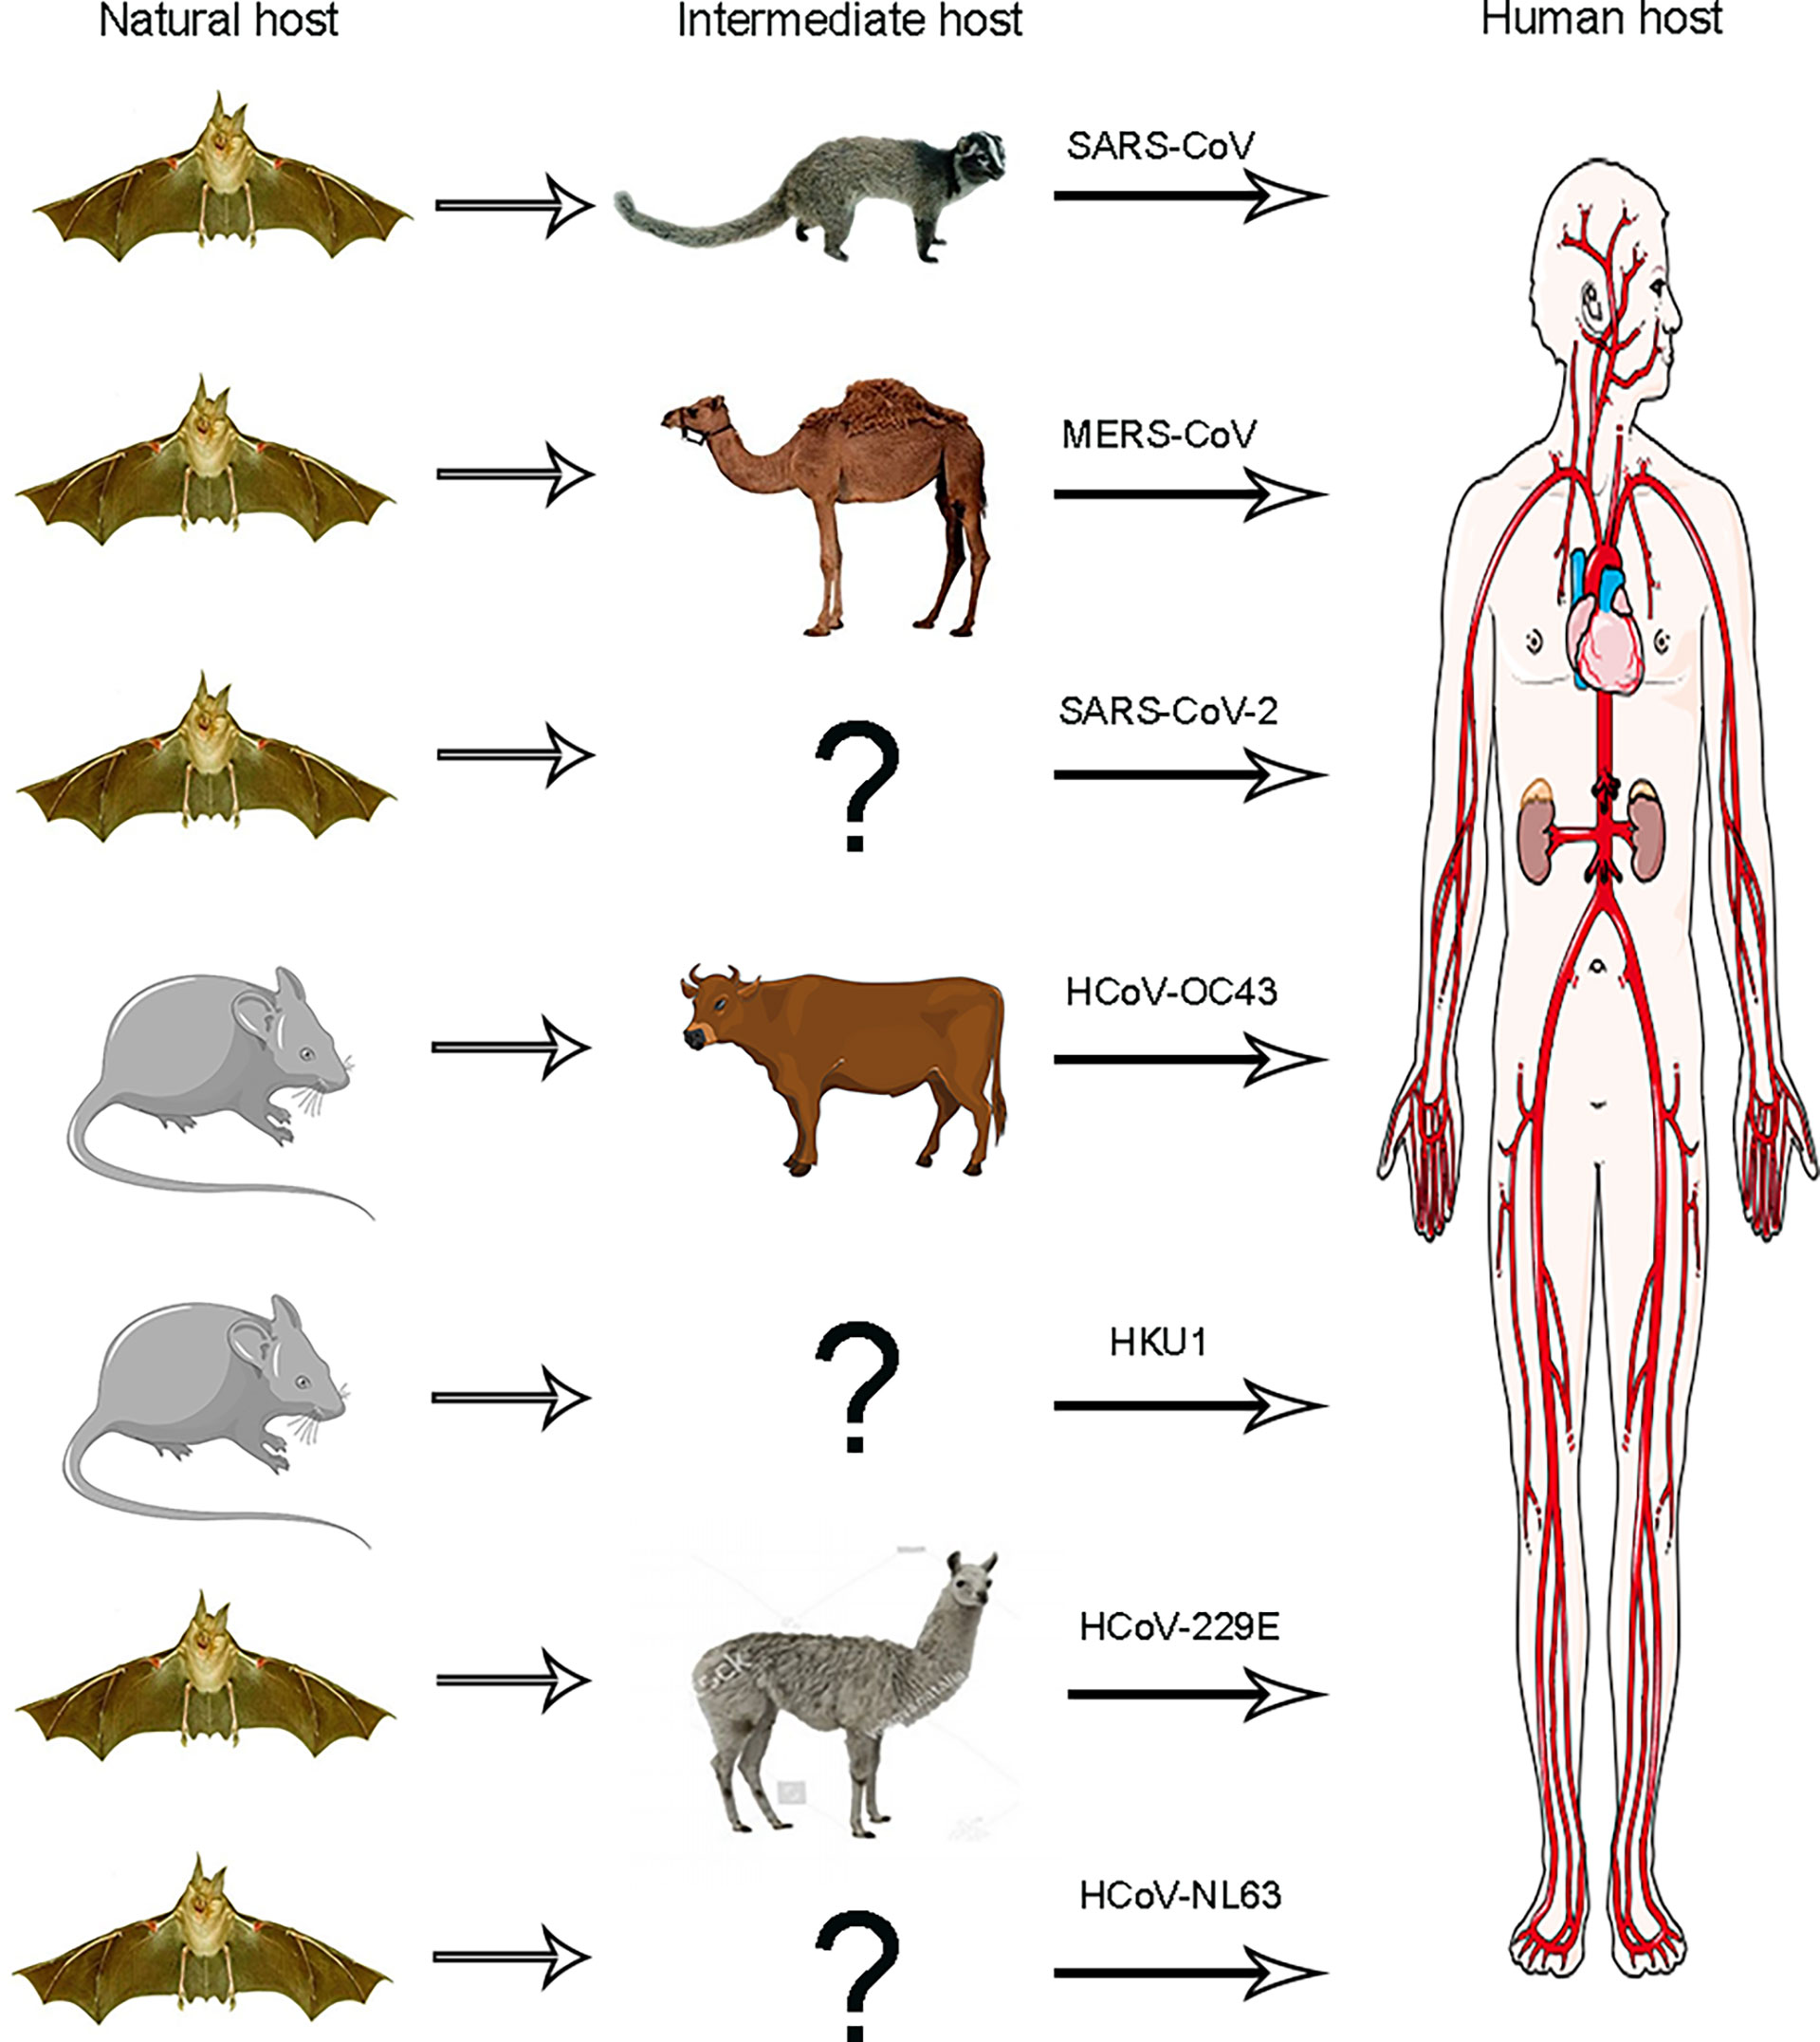
Many CoVs transmit (and adapt) via intermediate hosts prior to infecting humans.
An intermediate host for SARS-CoV-2 has not yet been identified.
Reservoir host
Ning et al. 2021. Front. Cell. Infect. Microbiol.

Slide 33
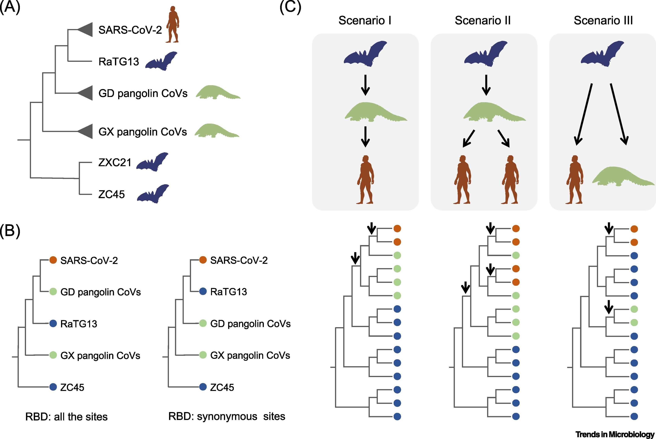
Bats likely sourced infections to both humans and pangolins in disparate spillover events (Scenario III)
Full genomes
Han 2020. Trends in Microbiology.

Slide 34
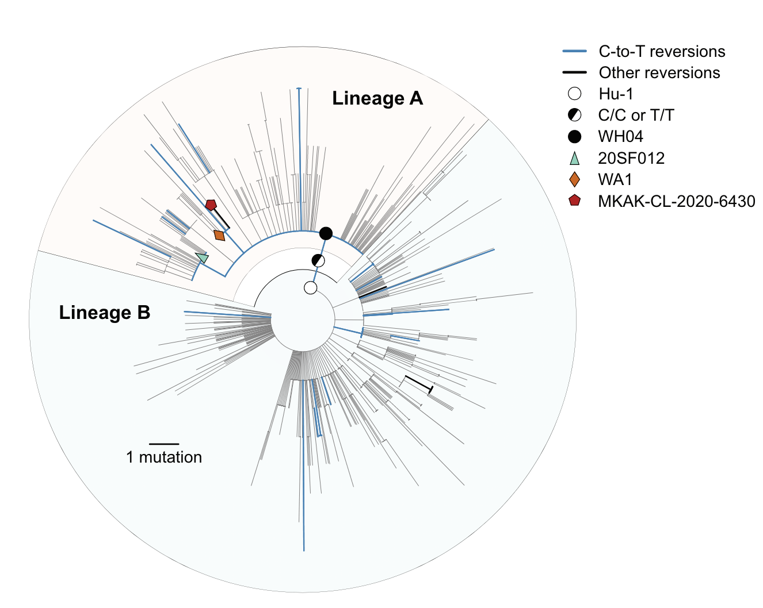
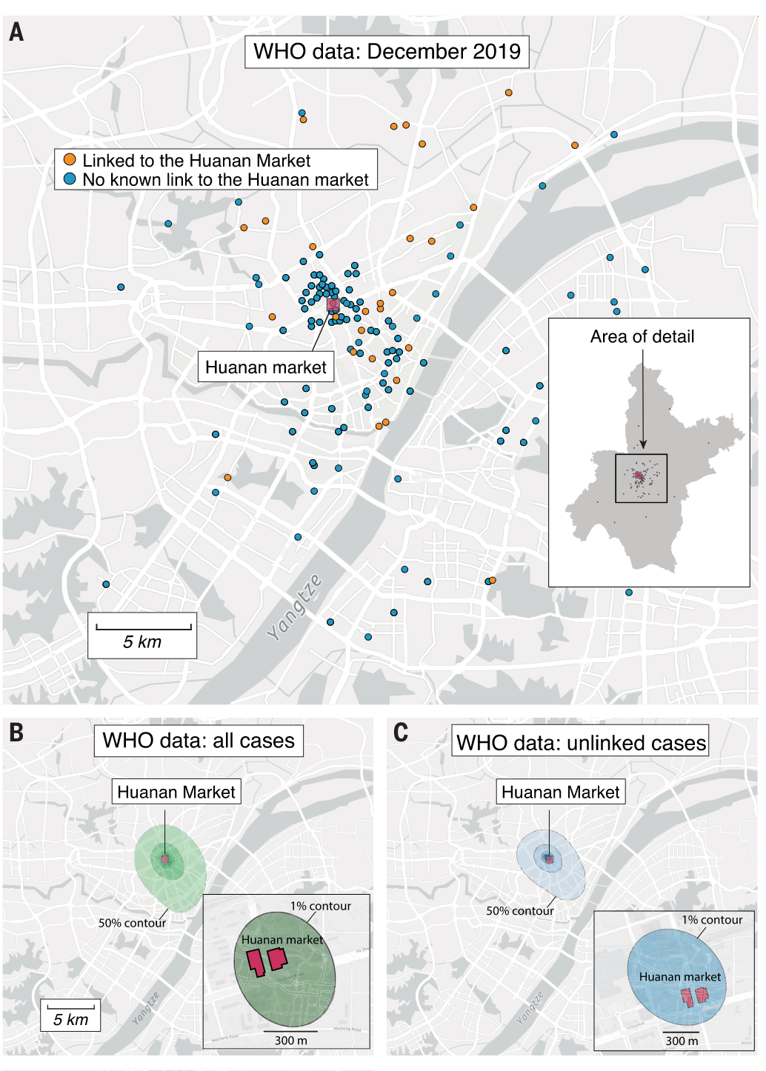
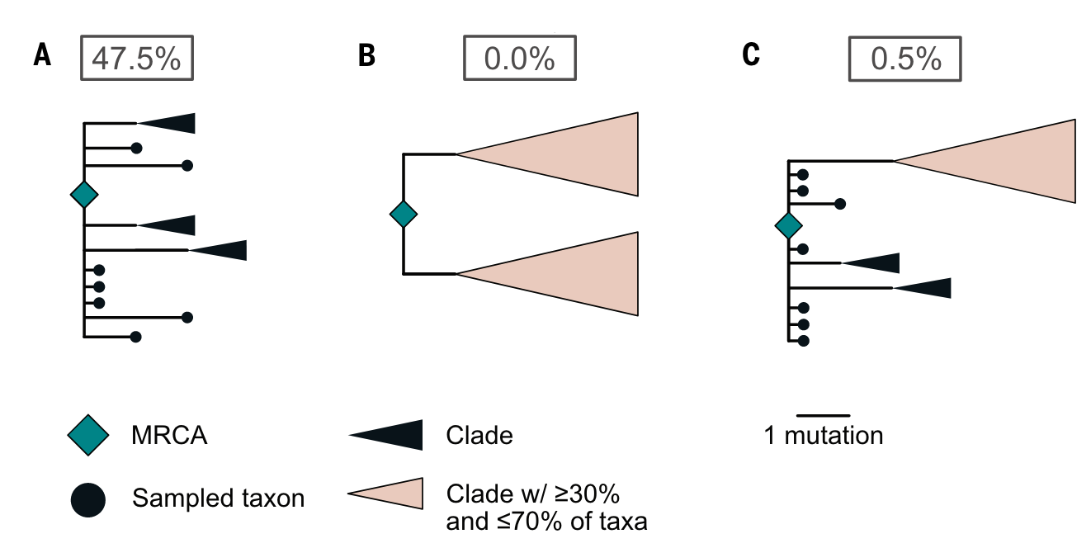
Phylogenetic analysis suggests multiple spillover origins of SARS-CoV-2 to humans.
Both lineages appear to have emerged from the Huanan Seafood Market.
Polytomy: a node on a phylogeny where more than 2 lineages descend from an ancestral lineage
Pekar et al. 2022. Science.
Worobey et al. 2022. Science.

Slide 35
Ebola & Marburg filovirus
Hendra & Nipah henipavirus
Rabies lyssavirus
But it is known that bats do act as natural reservoirs and maintenance hosts for the majority of the world’s most virulent zoonotic viruses.
SARS, MERS, SARS-CoV-2 coronaviruses
Virulence is the extent of a pathogen’s harm to the host.
Notes:
Leading researchers to ask, are bats somehow special in their capacity as zoonotic hosts?

Slide 36
But it is known that bats do act as natural reservoirs and maintenance hosts for the majority of the world’s most virulent zoonotic viruses.
Virulence is the extent of a pathogen’s harm to the host.
Guth et al. 2019. Phil Trans Roy Soc.
Guth et al. 2022. PNAS.
Notes:
Leading researchers to ask, are bats somehow special in their capacity as zoonotic hosts?

Slide 37
Why do pathogens make us sick?

Slide 38

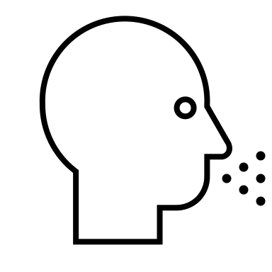

Why do pathogens make us sick?
A virus will evolve to maximize its capacity for between-host infections (R₀).
Alizon et al. 2008. J Evolutionary Biology
Anderson and May 1982. Parasitology.
Notes:
Typically, we predict that a virus will evolve traits that maximize its capacity for reproducing itself by infecting new hosts, achieving a baseline viral density within a single individual that produces sufficient virions in excretia – like the cough shown here – to go on to infect new hosts

Slide 39


Why do pathogens make us sick?
A virus will evolve to maximize its capacity for between-host infections (R₀).
$$β$$
transmission
Alizon et al. 2008. J Evolutionary Biology
Anderson and May 1982. Parasitology.
Notes:
Typically, we predict that a virus will evolve traits that maximize its capacity for reproducing itself by infecting new hosts, achieving a baseline viral density within a single individual that produces sufficient virions in excretia – like the cough shown here – to go on to infect new hosts

Slide 40
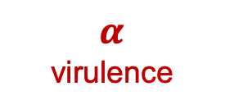
Why do pathogens make us sick?
A virus will evolve to maximize its capacity for between-host infections (R₀).
$$α$$
virulence
$$β$$
transmission
Mechanisms that promote transmission may also enhance virulence to the host.
Alizon et al. 2008. J Evolutionary Biology
Anderson and May 1982. Parasitology.
Notes:
Typically, we predict that a virus will evolve traits that maximize its capacity for reproducing itself by infecting new hosts, achieving a baseline viral density within a single individual that produces sufficient virions in excretia – like the cough shown here – to go on to infect new hosts

Slide 41
Why do pathogens make us sick?
A virus will evolve to maximize its capacity for between-host infections (R₀).
Virulence, then, is a by-product of a pathogen’s need to transmit for reproduction!
$$α$$
virulence
$$β$$
transmission
Mechanisms that promote transmission may also enhance virulence to the host.
Alizon et al. 2008. J Evolutionary Biology
Anderson and May 1982. Parasitology.
Notes:
Typically, we predict that a virus will evolve traits that maximize its capacity for reproducing itself by infecting new hosts, achieving a baseline viral density within a single individual that produces sufficient virions in excretia – like the cough shown here – to go on to infect new hosts

Slide 42
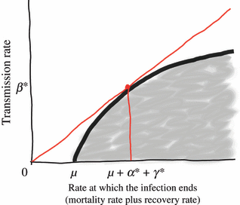
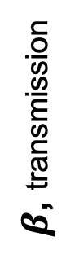
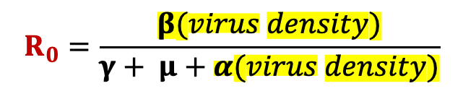
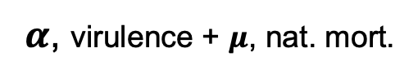
Why do pathogens make us sick?
A virus will evolve to maximize its capacity for between-host infections (R₀).
$$α$$
virulence
As a result, we predict the evolution of “optimal virulence.”
$$β$$
transmission
$β$, transmission
Mechanisms that promote transmission may also enhance virulence to the host.
$α$, virulence + $μ$, nat. mort.
infections created
$$R_{0}=\frac{β(virus density)}{γ+ μ+α(virus density)}$$
Alizon et al. 2008. J Evolutionary Biology
Anderson and May 1982. Parasitology.
infections lost
Notes:
Typically, we predict that a virus will evolve traits that maximize its capacity for reproducing itself by infecting new hosts, achieving a baseline viral density within a single individual that produces sufficient virions in excretia – like the cough shown here – to go on to infect new hosts

Slide 43

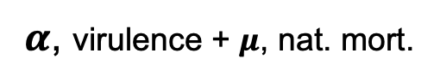
Why do pathogens make us sick?
A virus will evolve to maximize its capacity for between-host infections (R₀).
$$α$$
virulence
As a result, we predict the evolution of “optimal virulence.”
$$β$$
transmission
$β$, transmission
Note that originally Anderson and May (1982) represented this link to virus density as acting on the disease recovery rate, though it is now more commonly expressed as a function of virulence!
Mechanisms that promote transmission may also enhance virulence to the host.
$α$, virulence + $μ$, nat. mort.
infections created
$$R_{0}=\frac{β(virus density)}{γ+ μ+α(virus density)}$$
Alizon et al. 2008. J Evolutionary Biology
Anderson and May 1982. Parasitology.
infections lost
Notes:
Typically, we predict that a virus will evolve traits that maximize its capacity for reproducing itself by infecting new hosts, achieving a baseline viral density within a single individual that produces sufficient virions in excretia – like the cough shown here – to go on to infect new hosts

Slide 44
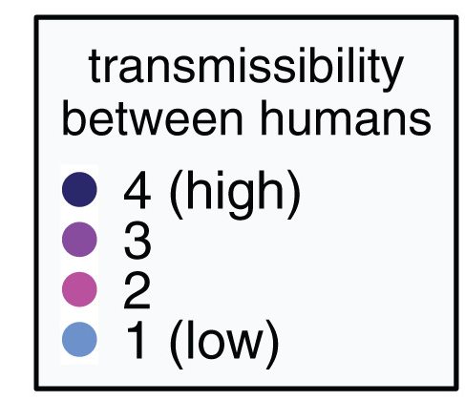
For zoonoses, virulence and transmission tradeoff to result in total death burden.
Guth et al. 2019. Phil Trans Roy Soc.
Guth et al. 2022. PNAS.
Notes:
Leading researchers to ask, are bats somehow special in their capacity as zoonotic hosts?

Slide 45
For zoonoses, virulence and transmission tradeoff to result in total death burden.
Guth et al. 2019. Phil Trans Roy Soc.
Guth et al. 2022. PNAS.
Notes:
Leading researchers to ask, are bats somehow special in their capacity as zoonotic hosts?

Slide 46
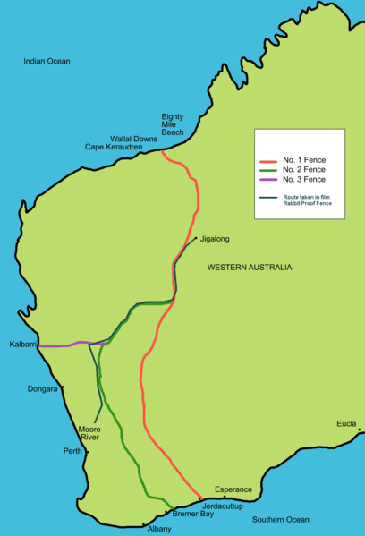
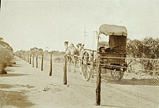
The virulence case study of rabbit Myxoma virus
1788: European rabbits brought to Australia as a food source
Rabbits quickly became feral and numbers soared.
1901: Australia constructed the famous “rabbit-proof fence” to attempt to keep rabbits out of agriculture in the West
Government looked to control measures, including biological controls in the 1930s.
Tried Myxoma virus, a highly virulent European poxvirus infecting rabbits. with a CFR >99%

Slide 47
The virulence case study of rabbit Myxoma virus
1788: European rabbits brought to Australia as a food source
Rabbits quickly became feral and numbers soared.
1901: Australia constructed the famous “rabbit-proof fence” to attempt to keep rabbits out of agriculture in the West.
Government looked to control measures, including biological controls in the 1930s.
Tried Myxoma virus, a highly virulent European poxvirus infecting rabbits. with a CFR >99%

Slide 48
The virulence case study of rabbit Myxoma virus
1788: European rabbits brought to Australia as a food source
Rabbits quickly became feral and numbers soared.
1901: Australia constructed the famous “rabbit-proof fence” to attempt to keep rabbits out of agriculture in the West.
Government looked to control measures, including biological controls in the 1930s.
Tried Myxoma virus, a highly virulent European poxvirus infecting rabbits. with a CFR >99%.

Slide 49
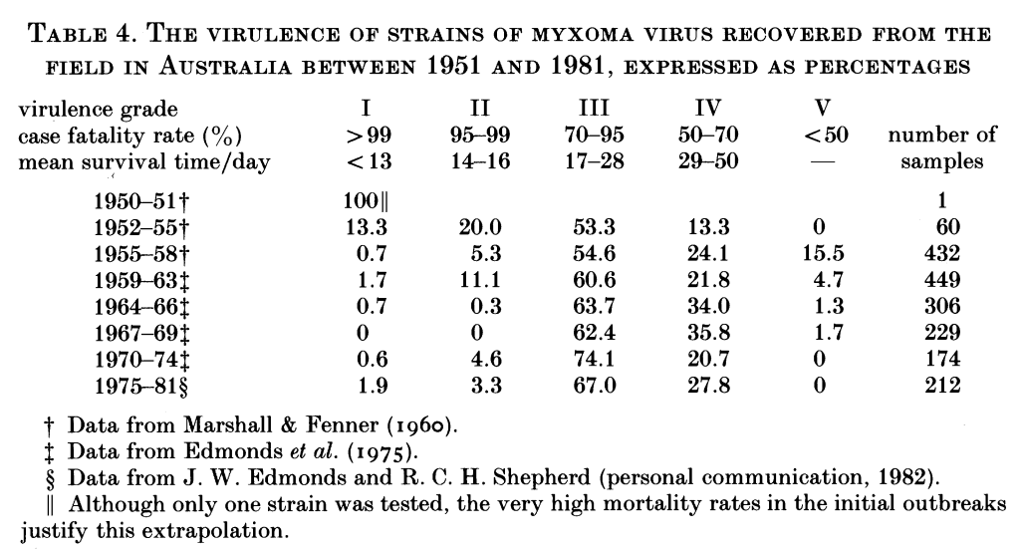
Myxoma virus evolved to intermediate virulence in just a single year.
Fenner 1983. Proc Roy Soc B

Slide 50
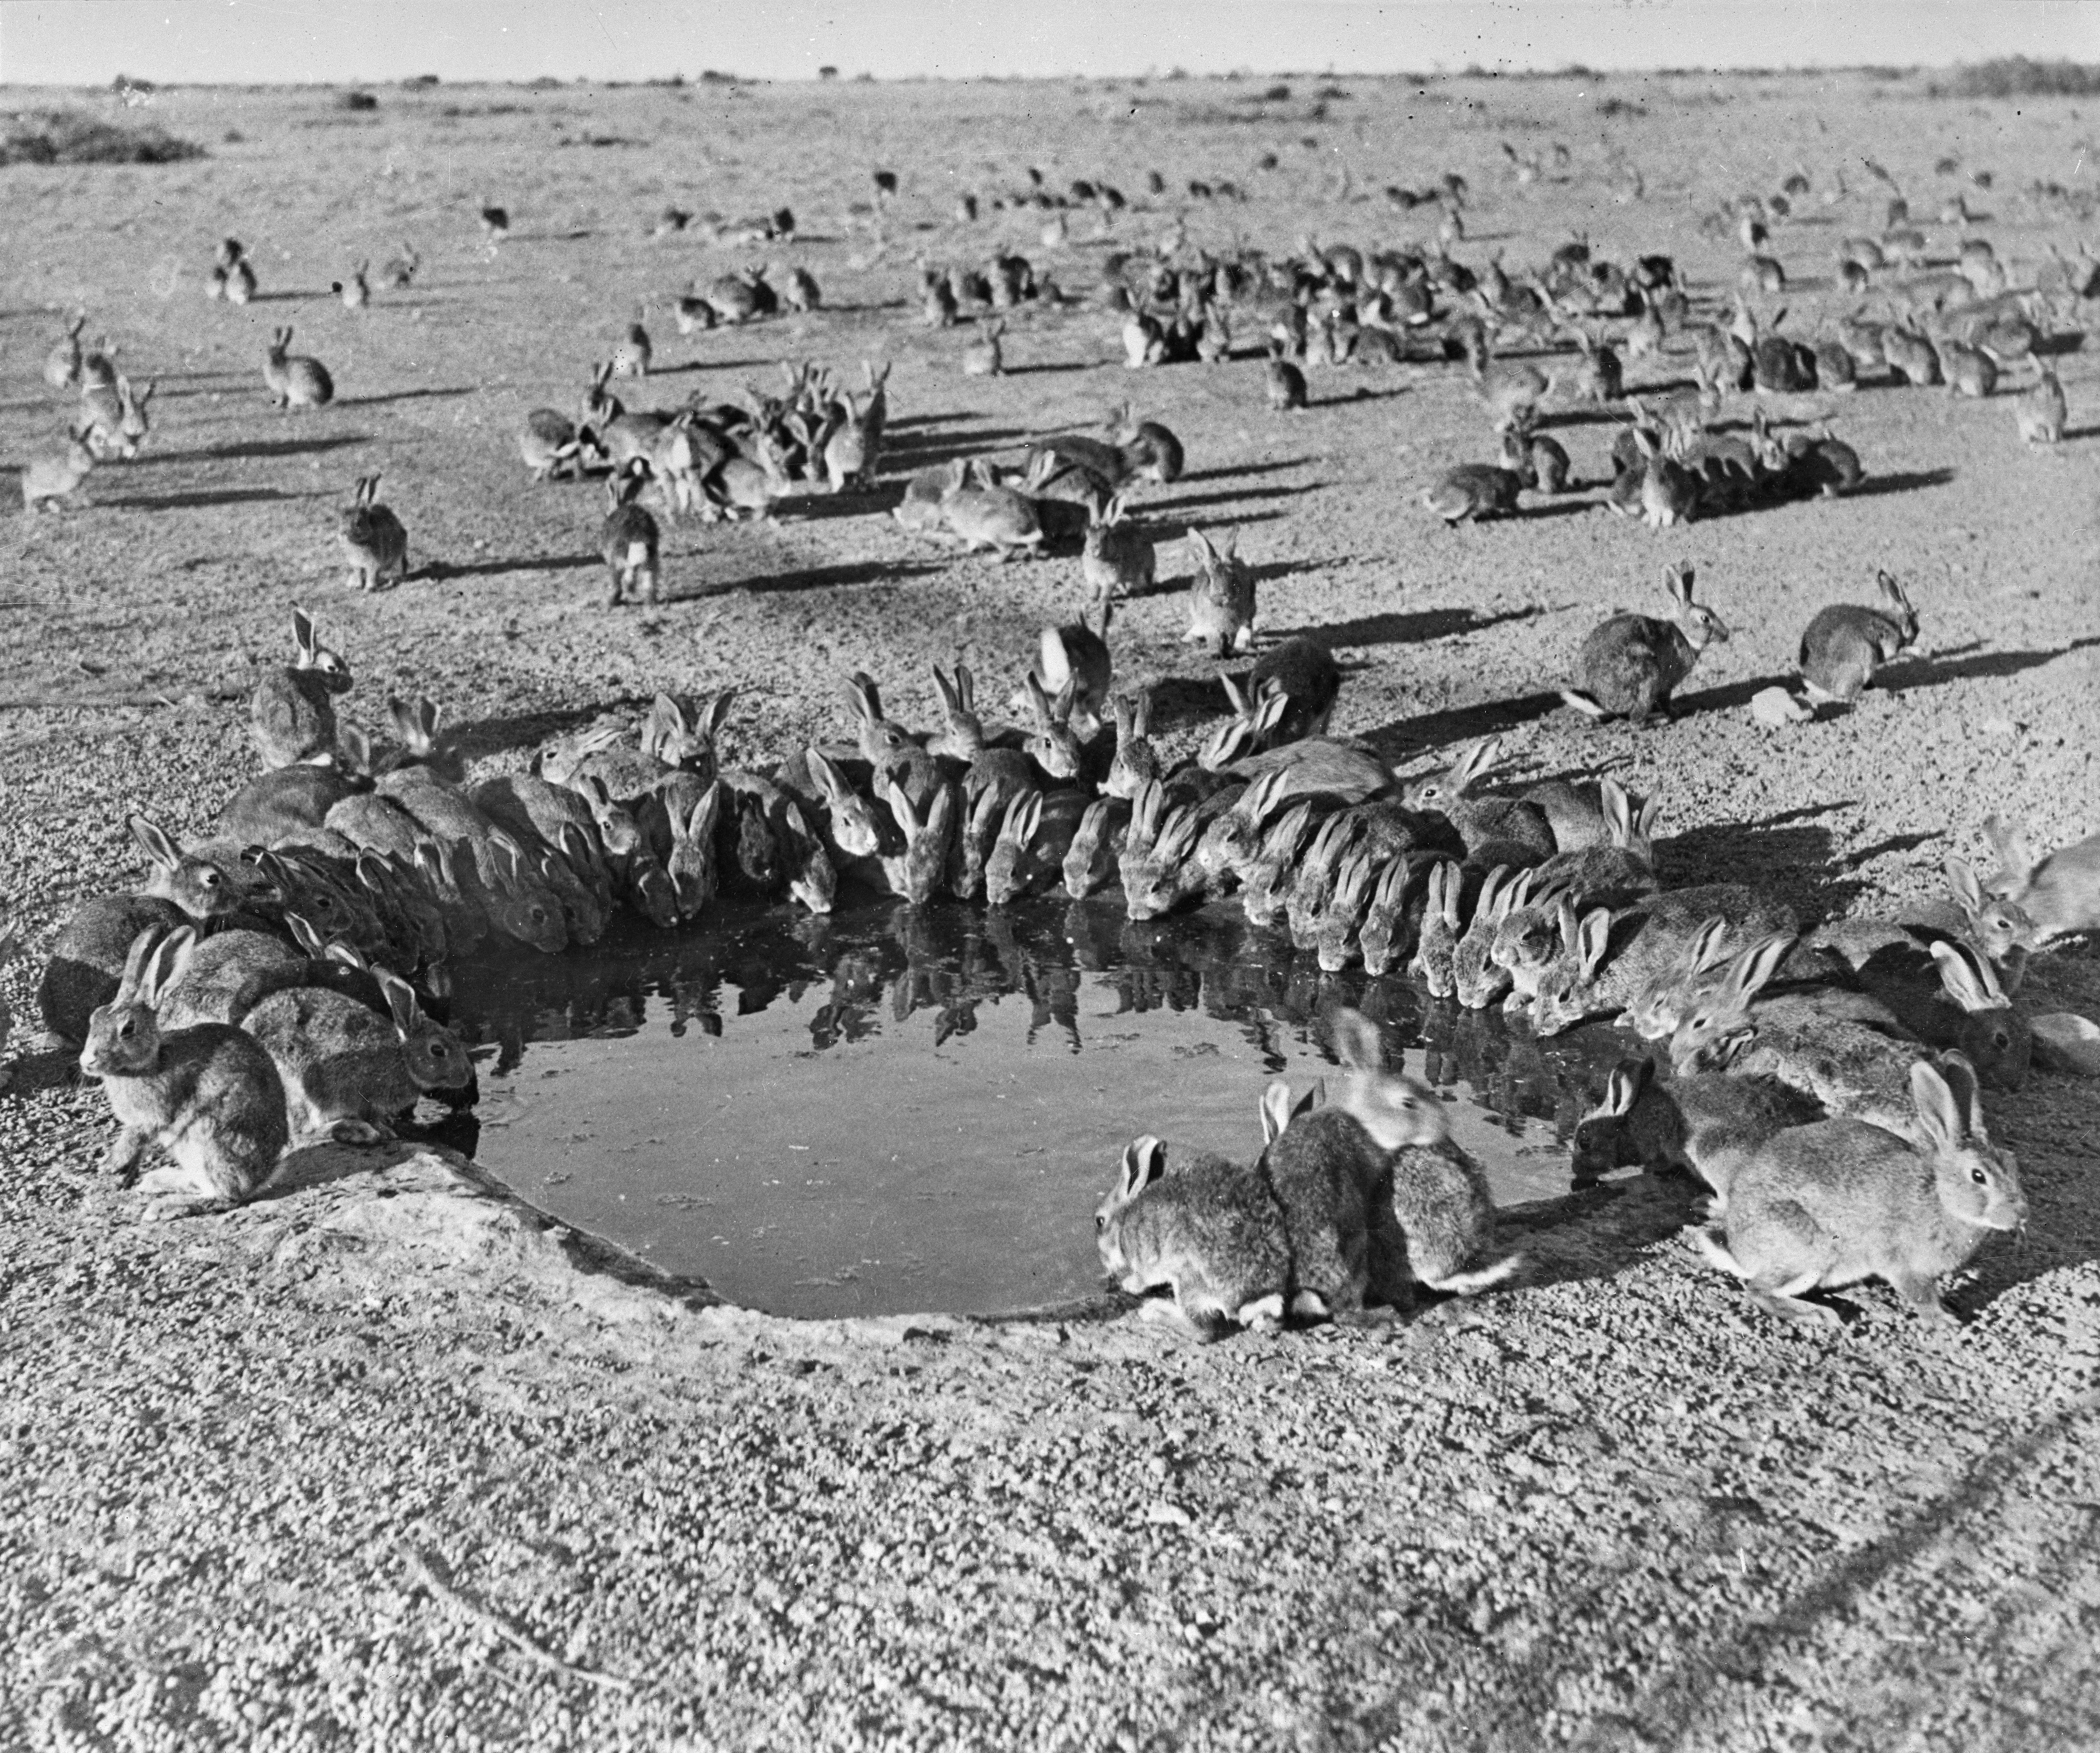
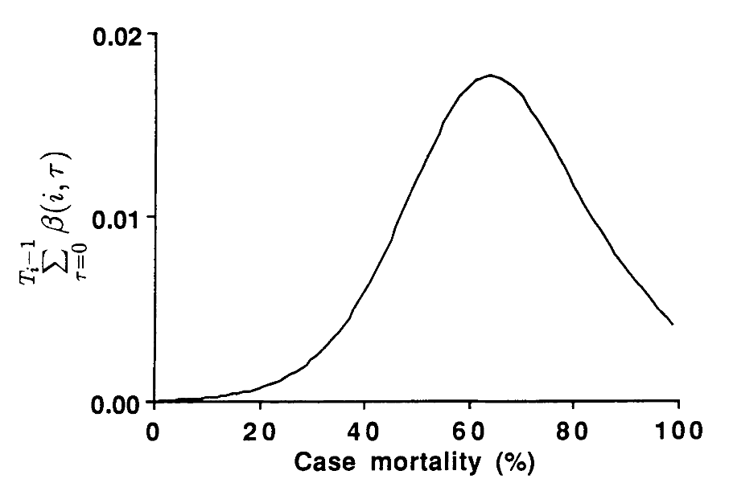
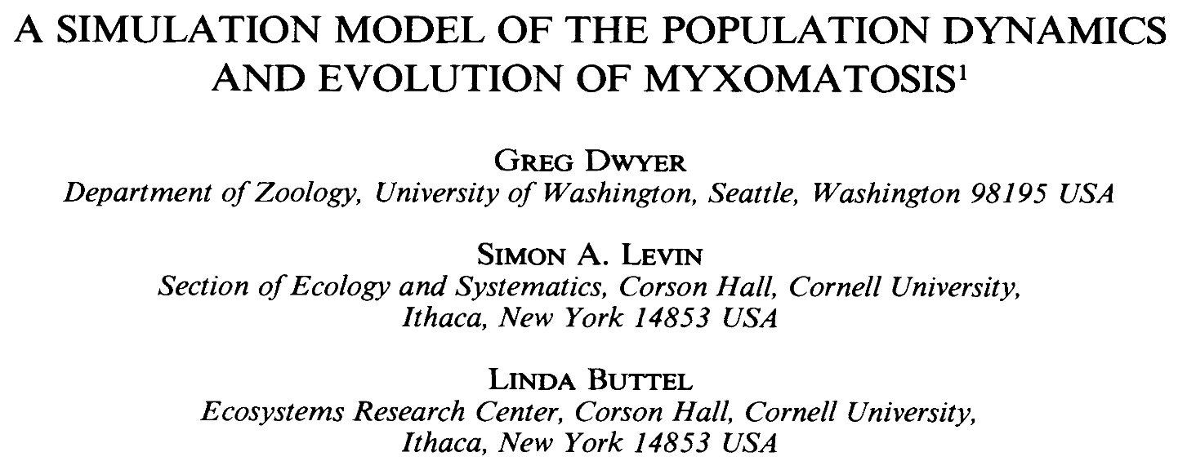
For Myxoma virus, intermediate virulence evolution resulted from optimization of the tradeoffs between virulence and transmission.
Cumulative transmission function, similar to R₀
Rabbits around a waterhole in the myxomatosis trial site on Wardang Island, Australia, 1938
Dwyer, Levin, and Buttel. 1990.
Ecological Monographs.

Slide 51
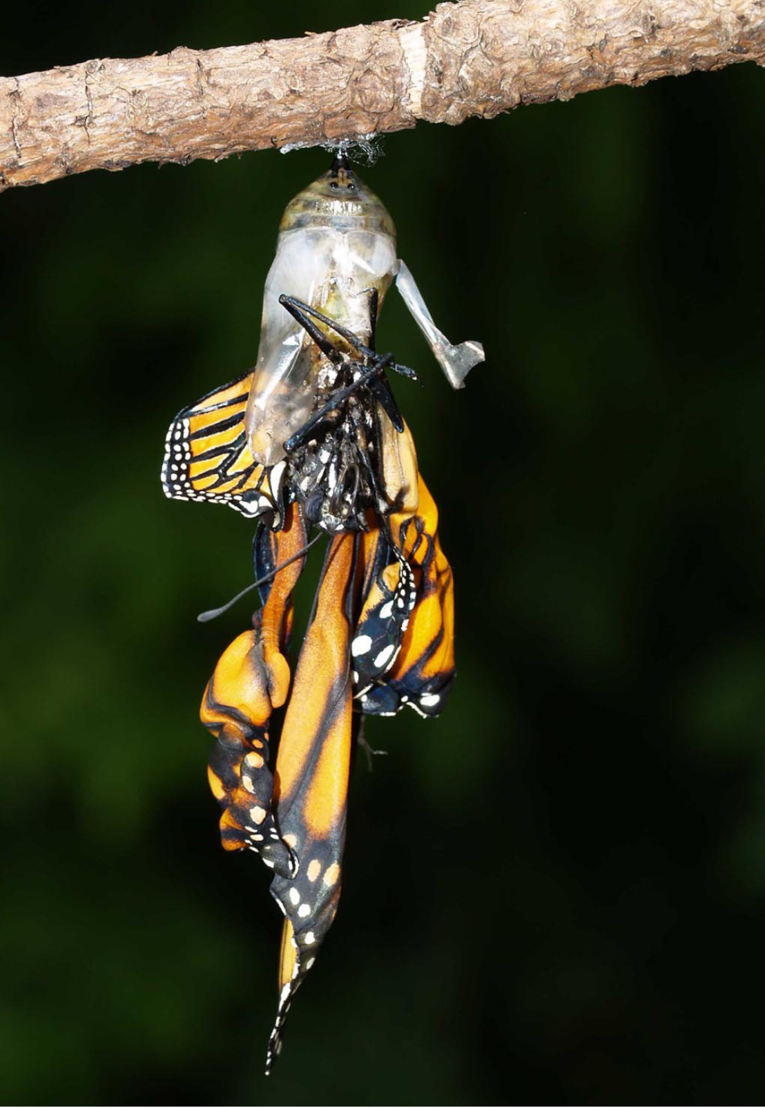
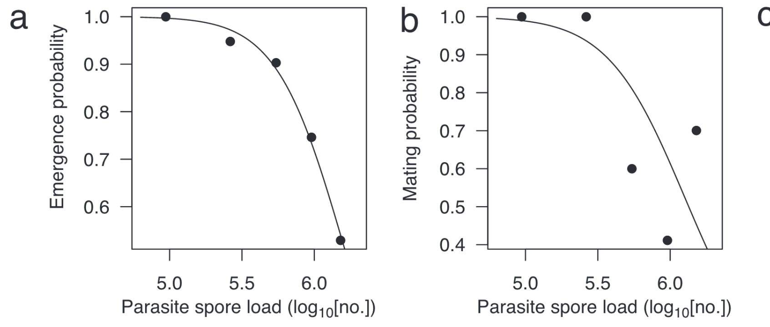
Another classic transmission-virulence tradeoff: parasites of monarch butterflies
Monarch butterflies infected with the protozoan parasite, Ophryocystis elektroscirrha, demonstrate reduced emergence and mating probabilities at higher parasite spore load (virulence).
de Roode et al. 2008. PNAS.

Slide 52
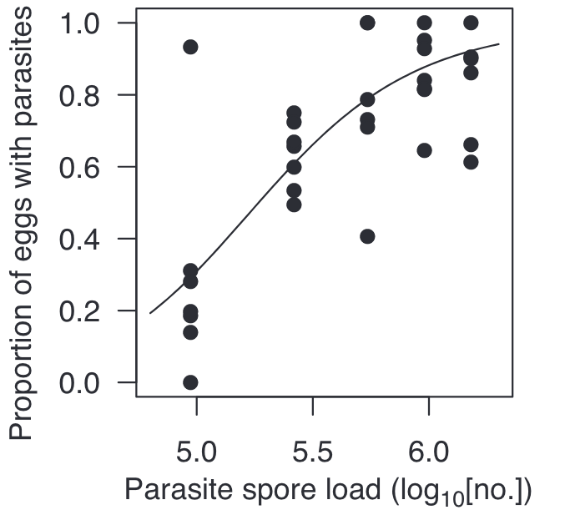
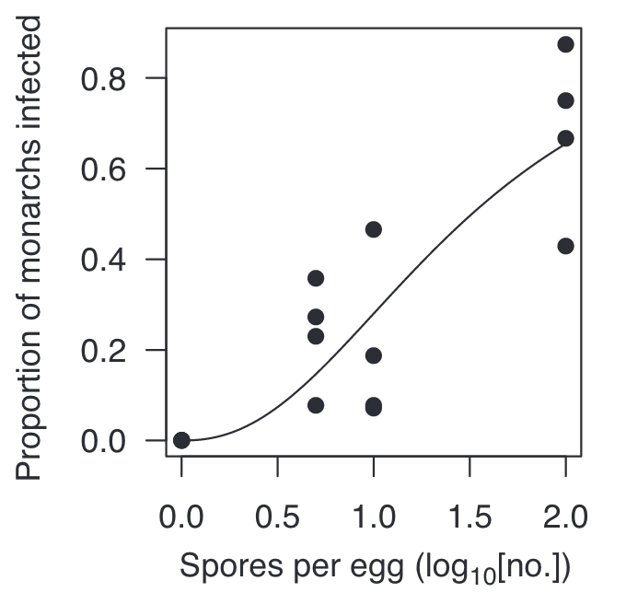

Another classic transmission-virulence tradeoff: parasites of monarch butterflies
Monarch butterflies infected with the protozoan parasite, Ophryocystis elektroscirrha, demonstrate reduced emergence and mating probabilities at higher parasite spore load (virulence).
On the flip side, higher parasite loads also led to increased transmission through higher proportions of monarch eggs that acquired spores and higher numbers of parasites per egg and milkweed leaf, which increased the probability of infection.
de Roode et al. 2008. PNAS.

Slide 53


Another classic transmission-virulence tradeoff: parasites of monarch butterflies
Monarch butterflies infected with the protozoan parasite, Ophryocystis elektroscirrha, demonstrate reduced emergence and mating probabilities at higher parasite spore load (virulence).
On the flip side, higher parasite loads also led to increased transmission through higher proportions of monarch eggs that acquired spores and higher numbers of parasites per egg and milkweed leaf, which increased the probability of infection.
Parasite fitness is calculated to be maximized at intermediate spore load.
$β$, transmission
$α$, virulence + $μ$, nat. mort.
de Roode et al. 2008. PNAS.

Slide 54
Why then are bat viruses so virulent [to humans]?
Guth et al. 2019. Phil Trans Roy Soc.
Guth et al. 2022. PNAS.
Notes:
Leading researchers to ask, are bats somehow special in their capacity as zoonotic hosts?

Slide 55
Why then are bat viruses so virulent [to humans]?
Mismatch of optimal virulence evolved in the reservoir host and a lack of viral tolerance in the spillover (human) host.
Guth et al. 2019. Phil Trans Roy Soc.
Guth et al. 2022. PNAS.
Notes:
Leading researchers to ask, are bats somehow special in their capacity as zoonotic hosts?

Slide 56
Bats appear highly tolerant of virus infection!
(They host viruses without experiencing disease)
Host health
Host health
Parasite burden
Parasite burden
resistance
tolerance
Boots 2008. TREE.
Raberg et al. 2007 Science.

Slide 57

Virus tolerance is linked to the evolution of flight.
Bats are the only flying mammals.
Flight is more metabolically expensive than any form of terrestrial locomotion.
O’Shea et al. 2014 EID
Brook and Dobson 2015 Trends Micro
Notes:
Flight is more metabolically expensive than any form of terrestrial locomotion.
A bat in flight will elevate its basal metabolic rate some 15-fold beyond resting, more than double that of a terrestrial mammal at full speed running.
Life history theory predicts an inverse correlation between metabolic activity and lifespan which bats defy.

Slide 58

Bats have elongated lifespans despite high metabolic rates.
bats
Jones et al. 2009 Ecology
Brook et al. In Revision. PLoS Biology.
Notes:
Life history theory predicts an inverse correlation between metabolic activity and lifespan which bats defy.

Slide 59


We hypothesize that:
unique anti-inflammatory pathways
evolved to enable flight
Brook and Dobson 2015 Trends Micro
Notes:
We explain this phenomenon
by hypothesizing that because flight is so metabolically costly, for it even to have been evolutionarily possible,
bats had to first
evolve unique anti-inflammatory pathways
including intracellular mechanisms of oxidative stress mitigation and DNA damage and repair

Slide 60

We hypothesize that:
bat longevity
unique anti-inflammatory pathways
evolved to enable flight
anti-cancer defenses
virus tolerance
Brook and Dobson 2015 Trends Micro
Notes:
and bats' unique viral tolerance,
both through mitigation of intracellular oxidative stress incurred by viruses directly, as well as through mitigation of inflammation incurred by antiviral immune defenses

Slide 61
A virus will evolve to maximize its capacity for between-host infections (R₀).
$$α$$
virulence
$$β$$
transmission
Mechanisms that promote transmission may also enhance virulence to the host.
Notes:
Typically, we predict that a virus will evolve traits that maximize its capacity for reproducing itself by infecting new hosts, achieving a baseline viral density within a single individual that produces sufficient virions in excretia – like the cough shown here – to go on to infect new hosts

Slide 62



A virus will evolve to maximize its capacity for between-host infections (R₀).
Bats accrue less virulence for a given level of transmission.
$$α$$
virulence
$$α$$
virulence
$$β$$
transmission
$$β$$
transmission
Mechanisms that promote transmission may also enhance virulence to the host.
Brook et al. In Revision. PLoS Biology.
Notes:
Typically, we predict that a virus will evolve traits that maximize its capacity for reproducing itself by infecting new hosts, achieving a baseline viral density within a single individual that produces sufficient virions in excretia – like the cough shown here – to go on to infect new hosts

Slide 63
A virus will evolve to maximize its capacity for between-host infections (R₀).
Bats accrue less virulence for a given level of transmission.
$$α$$
virulence
$$α$$
virulence
$$β$$
transmission
$$β$$
transmission
Mechanisms that promote transmission may also enhance virulence to the host.
Bat reservoirs may evolve virus traits that cause virulence in non-bats.
Brook et al. In Revision. PLoS Biology.
Notes:
Typically, we predict that a virus will evolve traits that maximize its capacity for reproducing itself by infecting new hosts, achieving a baseline viral density within a single individual that produces sufficient virions in excretia – like the cough shown here – to go on to infect new hosts

Slide 64



A virus will evolve to maximize its capacity for between-host infections (R₀).
Bats accrue less virulence for a given level of transmission.
$α$($r^{∗}$)
virulence
$$α$$
virulence
$$β$$
transmission
$$β(r^{∗})$$
transmission
Mechanisms that promote transmission may also enhance virulence to the host.
$r^{∗}$within-host virus growth rate
Bat reservoirs may evolve virus traits that cause virulence in non-bats.
Brook et al. In Revision. PLoS Biology.
Notes:
Typically, we predict that a virus will evolve traits that maximize its capacity for reproducing itself by infecting new hosts, achieving a baseline viral density within a single individual that produces sufficient virions in excretia – like the cough shown here – to go on to infect new hosts

Slide 65










Bat reservoirs may evolve virus traits that cause virulence in non-bats.
$r^{∗}$within-host virus growth rate
$$Spillover host$$
$$r_{R}^{∗}$$
$$β_{S}(r_{R}^{∗})$$
$$α_{S}(r_{R}^{∗})$$
$$r_{R}^{∗}$$
$$β_{R}^{∗}(r_{R}^{∗})$$
$$α_{R}^{∗}(r_{R}^{∗})$$
$$Reservoir$$
Brook et al. In Revision. PLoS Biology.

Slide 66
Bat reservoirs may evolve virus traits that cause virulence in non-bats.
$r^{∗}$within-host virus growth rate
optimal transmission in reservoir
optimal virus replication in reservoir
optimal virulence in reservoir
$$Spillover host$$
$$r_{R}^{∗}$$
$$β_{S}(r_{R}^{∗})$$
$$α_{S}(r_{R}^{∗})$$
$$r_{R}^{∗}$$
$$β_{R}^{∗}(r_{R}^{∗})$$
$$α_{R}^{∗}(r_{R}^{∗})$$
$$Reservoir$$
Brook et al. In Revision. PLoS Biology.

Slide 67

Bat reservoirs may evolve virus traits that cause virulence in non-bats.
$r^{∗}$within-host virus growth rate
optimal transmission in reservoir
optimal virus replication in reservoir
optimal virulence in reservoir
$$r_{R}^{∗}$$
$$β_{S}(r_{R}^{∗})$$
$$α_{S}(r_{R}^{∗})$$
$$r_{R}^{∗}$$
$$β_{R}^{∗}(r_{R}^{∗})$$
$$α_{R}^{∗}(r_{R}^{∗})$$
$$Reservoir$$
$$Spillover host$$
Brook et al. In Revision. PLoS Biology.

Slide 68
Bat reservoirs may evolve virus traits that cause virulence in non-bats.
$r^{∗}$within-host virus growth rate
Transmission determined by reservoir-evolved virus growth rate
optimal transmission in reservoir
Reservoir-evolved virus growth rate
Maladaptive virulence in spillover host
optimal virus replication in reservoir
optimal virulence in reservoir
$$r_{R}^{∗}$$
$$β_{S}(r_{R}^{∗})$$
$$α_{S}(r_{R}^{∗})$$
$$r_{R}^{∗}$$
$$β_{R}^{∗}(r_{R}^{∗})$$
$$α_{R}^{∗}(r_{R}^{∗})$$
$$Reservoir$$
$$Spillover host$$
Brook et al. In Revision. PLoS Biology.

Slide 69
Limitations of the tradeoff model
The ‘trade-off hypothesis’ offers an explanation for the disease inflicted by parasites and pathogens on their original hosts. While well-designed theoretically, it has not been historically well-supported empirically!
This is partly due to challenges arising from the difficulty of measuring (and defining) transmission and virulence.
Virulence is a fitness cost that the parasite inflicts on the host, but these can take diverse forms, with differing consequences for the evolution of virulence.
(e.g. fitness effects on reproduction vs. adult mortality)
Sometimes, virulence is the result of the host’s immune response, rather than the direct impact of the parasite itself, further complicating dynamics
In the case of zoonoses, the bulk of our measurements may be derived from a different host than the one in which the virus evolved
Many examples of cases in which transmission is decoupled from virulence, due to more complex transmission dynamics.
Ex: Ebola (transmission after death )
Ex: COVID (transmission high in the respiratory tract; morbidity low in the RT)

Slide 70
Limitations of the tradeoff model
The ‘trade-off hypothesis’ offers an explanation for the disease inflicted by parasites and pathogens on their original hosts. While well-designed theoretically, it has not been historically well-supported empirically!
This is partly due to challenges arising from the difficulty of measuring (and defining) transmission and virulence.
Virulence is a fitness cost that the parasite inflicts on the host, but these can take diverse forms, with differing consequences for the evolution of virulence.
For example: Fitness effects on reproduction vs. adult mortality
Sometimes, virulence is the result of the host’s immune response, rather than the direct impact of the parasite itself, further complicating dynamics
In the case of zoonoses, the bulk of our measurements may be derived from a different host than the one in which the virus evolved
Many examples of cases in which transmission is decoupled from virulence, due to more complex transmission dynamics.
Ex: Ebola (transmission after death )
Ex: COVID (transmission high in the respiratory tract; morbidity low in the RT)

Slide 71
Limitations of the tradeoff model
The ‘trade-off hypothesis’ offers an explanation for the disease inflicted by parasites and pathogens on their original hosts. While well-designed theoretically, it has not been historically well-supported empirically!
This is partly due to challenges arising from the difficulty of measuring (and defining) transmission and virulence.
Virulence is a fitness cost that the parasite inflicts on the host, but these can take diverse forms, with differing consequences for the evolution of virulence.
For example: Fitness effects on reproduction vs. adult mortality
Sometimes, virulence is the result of the host’s immune response, rather than the direct impact of the parasite itself, further complicating dynamics
In the case of zoonoses, the bulk of our measurements may be derived from a different host than the one in which the virus evolved
Many examples of cases in which transmission is decoupled from virulence, due to more complex transmission dynamics.
Ex: Ebola (transmission after death )
Ex: COVID (transmission high in the respiratory tract; morbidity low in the RT)

Slide 72


Sometimes, virulence is the result of the host’s immune response, rather than the direct impact of the parasite itself
Self-reactive antibodies (ANA) promote survival by downregulating worms in crash years but impede survival via immunopathology in peak years!
Graham et al. 2010. Science.

Slide 73
Limitations of the tradeoff model
The ‘trade-off hypothesis’ offers an explanation for the disease inflicted by parasites and pathogens on their original hosts. While well-designed theoretically, it has not been historically well-supported empirically!
This is partly due to challenges arising from the difficulty of measuring (and defining) transmission and virulence.
Virulence is a fitness cost that the parasite inflicts on the host, but these can take diverse forms, with differing consequences for the evolution of virulence.
For example: Fitness effects on reproduction vs. adult mortality
Sometimes, virulence is the result of the host’s immune response, rather than the direct impact of the parasite itself, further complicating dynamics
In the case of zoonoses, the bulk of our measurements may be derived from a different host than the one in which the virus evolved
Many examples of cases in which transmission is decoupled from virulence, due to more complex transmission dynamics.
Ex: Ebola (transmission after death )
Ex: COVID (transmission high in the respiratory tract; morbidity low in the RT)

Slide 74

Limitations of the tradeoff model
The ‘trade-off hypothesis’ offers an explanation for the disease inflicted by parasites and pathogens on their original hosts. While well-designed theoretically, it has not been historically well-supported empirically!
This is partly due to challenges arising from the difficulty of measuring (and defining) transmission and virulence.
Virulence is a fitness cost that the parasite inflicts on the host, but these can take diverse forms, with differing consequences for the evolution of virulence.
For example: Fitness effects on reproduction vs. adult mortality
Sometimes, virulence is the result of the host’s immune response, rather than the direct impact of the parasite itself, further complicating dynamics
In the case of zoonoses, the bulk of our measurements may be derived from a different host than the one in which the virus evolved
Many examples of cases in which transmission is decoupled from virulence, due to more complex transmission dynamics.
Ex: Ebola (transmission after death)
Ex: COVID (transmission high in the respiratory tract; morbidity low in the RT)

Slide 75
Limitations of the tradeoff model
The ‘trade-off hypothesis’ offers an explanation for the disease inflicted by parasites and pathogens on their original hosts. While well-designed theoretically, it has not been historically well-supported empirically!
This is partly due to challenges arising from the difficulty of measuring (and defining) transmission and virulence.
Virulence is a fitness cost that the parasite inflicts on the host, but these can take diverse forms, with differing consequences for the evolution of virulence.
For example: Fitness effects on reproduction vs. adult mortality
Sometimes, virulence is the result of the host’s immune response, rather than the direct impact of the parasite itself, further complicating dynamics
In the case of zoonoses, the bulk of our measurements may be derived from a different host than the one in which the virus evolved
Many examples of cases in which transmission is decoupled from virulence, due to more complex transmission dynamics.
Ex: Ebola (transmission after death)
Ex: COVID (transmission high in the respiratory tract; morbidity low in the RT)
A few specific applications of tradeoff theory…

Slide 76

Spatial structuring generally favors reduced pathogen virulence.
Boots and Sasaki. 1999. Proc Roy Soc B.

Slide 77

Spatial structuring generally favors reduced pathogen virulence.
Boots and Sasaki. 1999. Proc Roy Soc B.
High and low virulence are both stable evolutionary outcomes when pathogens generate acquired immunity in spatially structured populations.
Boots et al. 2004. Science.

Slide 78


Spatial structuring generally favors reduced pathogen virulence.
Boots and Sasaki. 1999. Proc Roy Soc B.
High and low virulence are both stable evolutionary outcomes when pathogens generate acquired immunity in spatially structured populations.
Here, low virulence is favored in dense environments and high virulence in sparse environments.
Boots et al. 2004. Science.

Slide 79



Imperfect vaccines can also support the evolution of virulence, depending on the lifestage of the pathogen that is targeted.
Malaria vaccines
transmission-blocking vaccines
infection blocking vaccines
anti-growth rate vaccines
Gandon et al. 2001. Nature.

Slide 80
Is this ecology or evolution?

Slide 81
Is this ecology or evolution?
Phylodynamics unites both
Grenfell et al. 2004. Science.

Slide 82



Is this ecology or evolution?
Phylodynamics unites both
SIR
SIRS
SILI
A.
B.
C.
A.
B.
C.
measles population phylogeny
influenza A
population phylogeny
HIV population phylogeny
Grenfell et al. 2004. Science.

Slide 83
Population Biology
Conservation Biology
Disease Ecology
Goal:
protect populations from extinction
Concept:
Minimum Viable Population size (MVP)
Approach:
protected area reserves
Goal:
protect populations from disease via pathogen extinction
Concept:
Critical Community Size (CCS)
Approach:
sanitation
vaccination

Slide 84

Community = interacting populations of different species
individual
population
fish
(x)
metapopulation
shark
(y)
community
How does fish abundance vary with changes in shark abundance?
ecosystem

Slide 85
Disease dynamics in the broader community

Slide 86



Disease dynamics in the broader community
Example: Lyme Disease
Lyme disease is a vector-borne disease caused by the bacterium, Borrellia burgdoferi, vectored by Ixodes especially Ixodes scapularis) ticks.
Nymph ticks are borne in the spring, feed on small mammal hosts through the summer, then reproduce (particularly on deer) in the fall before going dormant in the winter.
Human cases are largely concentrated in the spring and summer and result from infected tick bites.

Slide 87


The dilution effect highlights buffering effects of biodiversity on disease transmission.
While a popular concept, it only holds in select cases!
In the case of Lyme, increasing host biodiversity tends to be associated with decreasing Lyme prevalence.
Dobson and Auld. 2016. The American Naturalist.
Ostfeld and Keesing. 2000. Conservation Biology.

Slide 88



The dilution effect highlights buffering effects of biodiversity on disease transmission.
While a popular concept, it only holds in select cases!
pathogen exacerbation
spurious dilution
true dilution
disease eradication
Dobson and Auld. 2016. The American Naturalist.
Wood et al. 2014. Ecology

